Slide 1

VOICE-COMMAND ACTIVATION OF JACO2 THROUGH ROS & PYTHON
Carlos Mella-Rijo Department of Electrical Engineering The University of Texas at Arlington
2023
DYNAMIC NETWORKS & CONTROL LABORATORY

Slide 2


PROJECT GOALS
I have already achieved voice control of another robotic arm, the TurtleBot 2i's PhantomX Pincher 5DOF arm. This project aims to be an extension of the former. Instead of a robot arm used as a learning tool, this functionality will be applied to an industrial grade arm so it may better fulfill its original purpose of aiding the motor impaired in an easier fashion than a joystick could. First the existing functionality will be applied to the new robot, then further improvements will be made for a seamless simple user experience that the voice commanded arm will be a benefit to users in everyday life.
DYNAMIC NETWORKS & CONTROL LABORATORY
5/15/2023
2

Slide 3

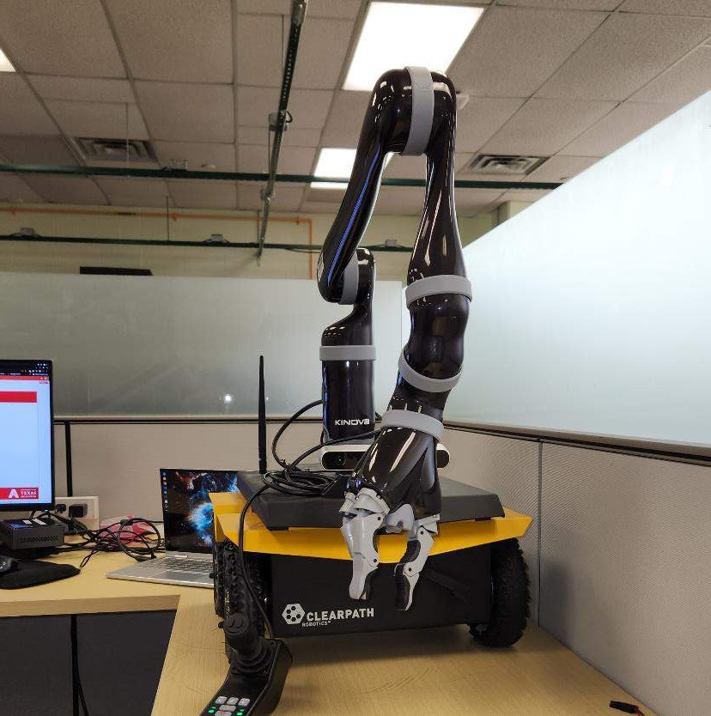
------SECTION ONE-------------------------
CREATING VOICE CONTROL FOR JACO ARM
Extending Voice
Control to Jaco
5/15/23 - 6/15/23
DYNAMIC NETWORKS &
3
CONTROL LABORATORY

Slide 4

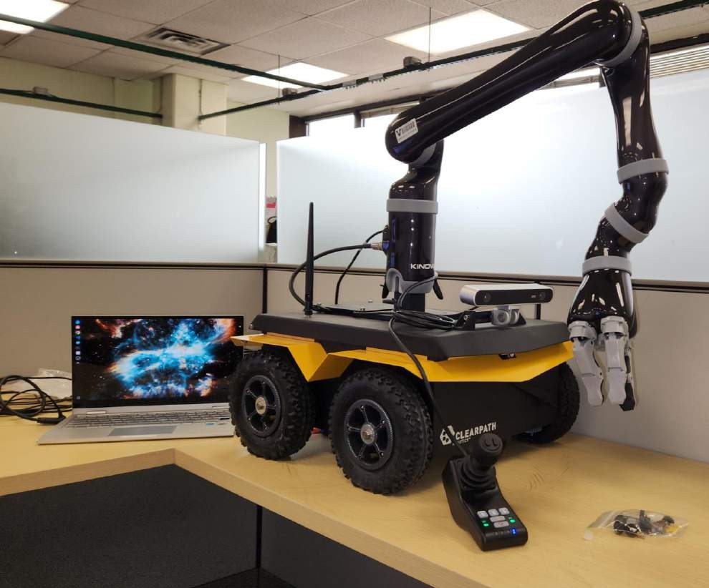
CLEARPATH JACKAL AND KINOVA JACO2
Provided Clearpath Robotics' Jackal UGV
Comes with Kinova Jaco2
arm
Jackal can provide power and data connections to the arm
For now, I am directly going to control the arm through USB to my Ubuntu laptop
Jackal has its own computer that could possibly be used for full control of the entire robot later
DYNAMIC NETWORKS & CONTROL LABORATORY
5/15/2023
4

Slide 5

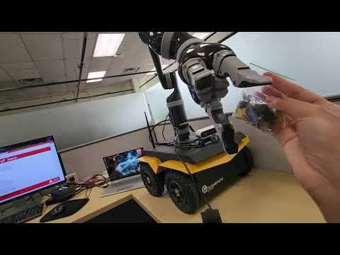
JOYSTICK MOVEMENT
Wanted to test Jaco's joints
before proceeding
Fixed Jaco2 upon ClearPath Jackal mount
No way to power it besides Jackal power plug
Battery seems to have charge – found charger in Kinova case
Controller connects to separate port in the back – all joints seem to
work correctly except for the "thumb" joint – though I may have just missed how to move it so far
DYNAMIC NETWORKS & CONTROL LABORATORY
5/25/23
5

Slide 6

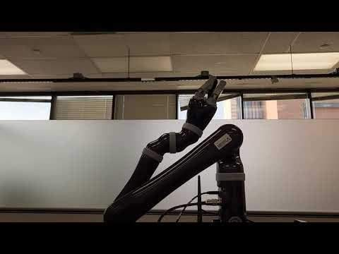
JOINT ACTION CLIENT MOVEMENT
Next step was to connect to PC
Takes USB2.0 type b connection
Downloaded kinova_ros packages
Built in separate workspace jaco_ws
Read Github readme – tried starting up Jaco
Some issues sprang up when trying to use it:
Had to edit launch file
for jaco : kinova_robot.launch
xacro.py is deprecated in noetic – had to edit out any instances of this being called. - replace with just "xacro" to
call xacro
Scripts seem to be written in python2 – had to update syntax to be usable with my installation – for example, the
"joints_action_client.py" script
Motion works differently
for jaco than with turtlebot_arm
Joint angle states published are
added to current position of arm instead of it being set to a fixed position measured by degrees
Ex. Publishing 10 deg to joint 2 which is at 10 deg will make it move to 20 deg
5/25/23

Slide 7

PLANNING POTENTIAL APP FEATURES
This behavior of joint action client moving a set relative distance changes how the code will operate:
Will need to specify quantities of movement when giving commands
Need to make commands translate seamlessly from colloquial
language
For example, I don't want user to say "move up in x radians"
Need to have compound movements be as simple as possible – don't want client to have to move every motor individually – was tedious enough with joystick
There is a cartesian action client that moves the end effector in
cartesian units of meters – solves all three problems
This also means that the speech recognition library will need to be extended
Also debating on whether to use a GUI or not
Voice gives more than enough feedback to user esp. If software is
headless like for example on a chair mount
Terminal should be able to help with debugging if necessary
However, GUI could provide a clearer status of what the arm is doing – could inlcude RViz and RQT somehow
5/25/23

Slide 8

FIGURING OUT CONTROL
Was trying out different ways to control the arm. Was having difficulties.
Did figure out some commands.
Command to return to home: "rosservice call /j2n6s300_driver/in/home_arm"
Command to use the JointVelocity message format:
rostopic pub -r
100 /j2n6s300_driver/in/joint_velocity kinova_msgs/JointVelocity "{joint1
: 0.0, joint2: 0.0, joint3: 0.0, joint4: 0.0, joint5: 0.0, joint6: 10.0}"
Cartesian control is proving difficult.
Cartesian command output topic is: /j2n6s300_driver/out/cartesian_command
Kinova states that "Cartesian position control can be realized by
calling KinovaComm::setCartesianPosition() in customized node."
Not sure how to use this yet. Opted to use included clients instead.
There are several python-based clients included that help facilitate motion: pose_action_client.py and joint_action_client.py
“Pose” takes inputs of cartesian position (x,y,z) relative to base link and quarternions for rotation ( x, y, z, w)
Refers specifically to location of end effector
“Joints” takes radian or degree inputs for each specific joint
They both add the values input by the user to the current values of the joints/positions. Will need their limits to not go over what motors can achieve. Jaco should have built in limits to prevent this, however pose action client would often not publish new inputs after first use. Suspect it might be taking the
5/29/23
8

Slide 9

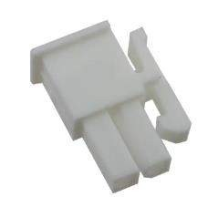
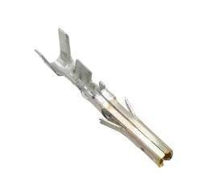
BATTERY DAMAGE
Batteries ran out before completing basic script – charger is broken – one of the pins in the battery’s charging port is melted and deformed
After searching for the correct connector online, decided to contact ClearPath, they gave me the correct listings on digikey:
Molex Connector: MiniFit Jr 5557
https://www.digikey.ca/en/products/ detail/molex/0039013028/2405392
Pins: 0457501211
https://www.digikey.ca/en/products/
detail/molex/0457501211/2404781
Parts were ordered but can't really use arm without battery since I have no other compatible connector
5/29/23
9

Slide 10

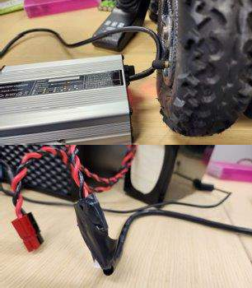
CHARGING WITH MELTED PORT
Spare parts were ordered to fix battery connector
In the meantime, it turns out there was sufficient contact with the broken connector to charge the battery while pressure is applied – reinforced with electrical tape so battery can charge.
Charger is not made for battery, and there is no indicator or shut off that I know of, so I must keep watch on it to make sure it does not exceed the charge capacity
Only way to check is to measure the voltage with a meter – easy to do since the charging connector is separate from the main prongs
The battery is Li-Ion
Nominal voltage is 26v, unsure what the peak charge capacity is – so will stop charging when it is at 26 v – check it every 5 minutes
Should hopefully only have to do this once while the parts are in transit
6/1/23

Slide 11

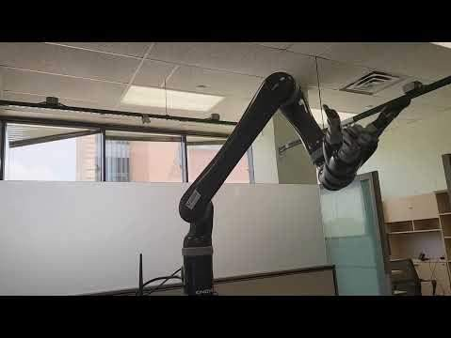
USING MOVEIT! SUCCESSFULLY
Tested out action clients, did not like how cumbersome they were
Tried out MoveIt! Once again and worked much better than before
Finally allows for easy way to
create compound movements.
Otherwise I would have had to deal with quarternions to send cartesian commands to Jaco.
"roslaunch j2n6s300_moveit_config j2n6s300_demo.launch"
6/1/23

Slide 12

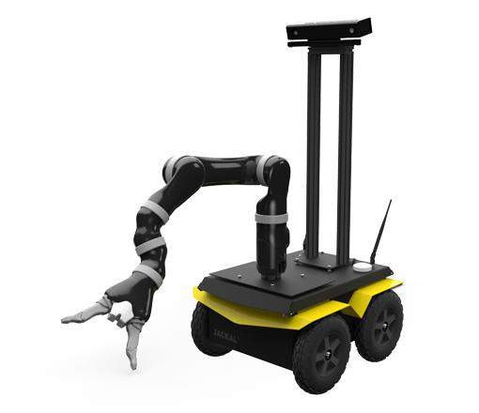
JACO ARM CARTESIAN DIRECTIONS
From kinova_ros readme:
The Cartesian coordinate of robot root frame is defined by the following rules:
origin is the intersection point of the bottom plane of the base and cylinder center line.
•+x axis is directing to the left when facing the base panel (where power switch and cable socket locate).
•+y axis is towards to user when facing
the base panel.
•+z axis is upwards when robot is standing on a flat surface.
+Z
-X
+Y
-Y
-Z
+X
DYNAMIC NETWORKS & CONTROL LABORATORY
6/1/23
12

Slide 13
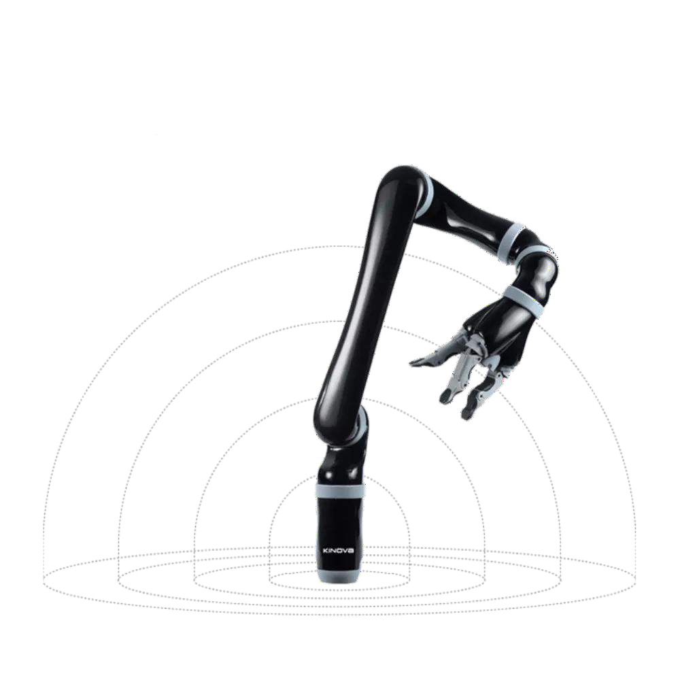


JACO ARM ROTATION DIRECTIONS
Arrows indicate direction of positive increment of radians
Joint 1:
Limits: [0 to 360]
Joint 2:
Limits: [47 deg to 313 deg]
Joint 3:
Limits: [19 deg to 341 deg]
Joint 4:
Limits: [0 to 360]
Joint 5:
Limits: [0 to 360]
Joint 6:
Limits: [0 to 360]
DYNAMIC NETWORKS & CONTROL LABORATORY
6/1/23
13

Slide 14

MOVEIT_COMMANDER TEST SCRIPT
import sys import rospy
import moveit_commander import faulthandler
With moveit_commander I was able to publish joint states directly to the robot – makes things a lot easier than the action clients
Can use this to facilitate voice command since the execution of the function can be tied to an event
Publishing joint states directly worked very well.
In MoveIt, I had set up custom poses with the set up client
Works Perfectly
faulthandler.enable() rospy.init_node('foo', anonymous=False) roscpp_initialize(sys.argv)
group_name = 'arm'
move_group = moveit_commander.MoveGroupCommander(group_name)
# gripper move_group2 group2_name = 'gripper'
move_group2 = moveit_commander.MoveGroupCommander(group2_name) move_group2.set_max_velocity_scaling_factor(1.0) move_group.set_max_velocity_scaling_factor(1.0)
joint_angles = [1, 1, 1, 1, 1, 1] # Replace with the desired joint angles move_group.set_joint_value_target(joint_angles)
# Set the named target state
named_target = "Vertical" # Replace with the name of the desired preset state move_group.set_named_target(named_target)
print("moving to pose 3...")
plan = move_group.go(wait=True) print("Finished!!!!!")
named_target2 = "Open" move_group2.set_named_target(named_target2) print("Opening Gripper...")
plan = move_group2.go(wait=True) print("Finished!!!!!")
named_target2 = "Close" move_group2.set_named_target(named_target2) print("Closing Gripper...")
plan = move_group2.go(wait=True) print("Finished!!!!!")
DYNAMIC NETWORKS &
6/1/23
CONTROL LABORATORY

Slide 15
JACO VOICE COMMAND SCRIPT
#! /usr/bin/env python #!/usr/bin/python -tt
# Printing Module Versions and Context information for clarity print('Porcupine version: %s' % porcupine.version) print('Rhino version: %s' % rhino.version)
print('Context info: %s' % rhino.context_info)
import os, struct, wave, pvporcupine, pvrhino, rospy, subprocess, faulthandler, threading
from datetime import datetime from pvrecorder import PvRecorder from std_msgs.msg import Float64 import numpy as np
from playsound import playsound as ps import tkinter as tk
from tkinter import *
from termcolor import colored import moveit_commander
# Creating and starting Recorder Instance
recorder = PvRecorder(device_index=5, frame_length=porcupine.frame_length)
# Parses keywords from porcupine keywords = list()
for x in keyword_paths:
keyword_phrase_part = os.path.basename(x).replace('.ppn', '').split('_') if len(keyword_phrase_part) > 6:
keywords.append(' '.join(keyword_phrase_part[0:-6])) else:
keywords.append(keyword_phrase_part[0])
#jacoapp.py - Main Script for Voice Control
# jointrad function, similar to turtlebot arm's but uses moveit_commander instead
def jointrad(armstate):
armstate = armstate arm.set_named_target(armstate) plan = arm.go(wait=True)
# Creates a wav file to store audio stream while in use wav_file = wave.open('wave.wav', "w") wav_file.setnchannels(1)
wav_file.setsampwidth(2) wav_file.setframerate(16000)
#ROS node that will publish states to MoveIt! rospy.init_node('JacoVoicer', anonymous=False)
# Instantiating Arm Group group_name = 'arm'
arm = moveit_commander.MoveGroupCommander(group_name) arm.set_max_velocity_scaling_factor(1.0)
# Enables 'faulthandler' - dumps Python tracebacks explicitly, on a fault, after a timeout, or on a user signal.
faulthandler.enable()
if name == ' main ':
try:
#Startup Sound - anything with ps is just playing the .wav files in the Audio folder. Also
made the terminal print out what turtlebot says. ps("bootup.wav")
print(colored('TURTLEBOT SAYS:','blue')+" Hello There!") print(colored('TURTLEBOT SAYS:','blue')+" I am Jaco the Arm.") print(colored('TURTLEBOT SAYS:','blue')+"I'm Listening...")
# Instantiating Hand Group
group2_name = 'gripper'
gripper = moveit_commander.MoveGroupCommander(group2_name) gripper.set_max_velocity_scaling_factor(1.0)
# declaring args for picovoice modules before using them
access_key = '2saeQ0pr4C5VaUWzNDyGAM3vUMli/zt6efotQubsLICInVRXZCRWOA=='# Required Picovoice Access Key keyword_paths = ['~/Desktop/Picovoice/Porcupine/Hey-Turtle-bot.ppn'] # Porcupine .ppn file path context_path = "/home/carlos/Desktop/Picovoice/Rhino/Arm.rhn" # Rhino .rhn file path
# Allows us to see selected audio device - can be changed with args print('Using device: %s' %recorder.selected_device)
# Creating Porcupine wake word engine and Rhino speech-to-intent engine instances porcupine = pvporcupine.create(access_key=access_key,keyword_paths=keyword_paths) rhino = pvrhino.create(access_key=access_key,context_path=context_path)
# Let client know script is currently listening print('Listening ... (press Ctrl+C to exit)')
6/5/23

Slide 16
JACO VOICE COMMAND SCRIPT (2)
print("Moving to 'Home'State...") armstate = 'Vertical' jointrad(armstate)
if inference.intent == 'move':
#move to Up state
if direction =='up': armstate = 'Vertical'
print(colored('TURTLEBOT SAYS:','blue')+" Moving Up.") rospy.loginfo("Moving to 'UP' state...") jointrad(armstate)
#move to Down state elif direction =='down':
armstate = 'Down'
print(colored('TURTLEBOT SAYS:','blue')+" Moving Up.") rospy.loginfo("Moving to 'UP' state...") jointrad(armstate)
#move to Left state
elif direction =='left':
armstate = 'Left'
print(colored('TURTLEBOT SAYS:','blue')+" Moving Up.") rospy.loginfo("Moving to 'UP' state...") jointrad(armstate)
print(colored('TURTLEBOT SAYS:','blue')+"I'm Listening...") recorder.start()
while True:
#make recorder parse speech from wave.wav pcm = recorder.read()
# Both Rhino and Porcupine are made to process it.
result = porcupine.process(pcm) is_finalized = rhino.process(pcm)
# storing wav data in array if wav_file is not None:
wav_file.writeframes(struct.pack("h" * len(pcm), *pcm))
# if wakeword is detected, stop and move to neutral if result >= 0:
recorder.stop()
print('[%s] Detected %s' % (str(datetime.now()), keywords[result])) print("Moving to 'Home'State...")
armstate = 'Vertical' jointrad(armstate)
print(colored('TURTLEBOT SAYS:','blue')+"I'm Listening...") recorder.start()
#move to Right state elif direction =='right':
armstate = 'Right'
print(colored('TURTLEBOT SAYS:','blue')+" Moving Up.") rospy.loginfo("Moving to 'UP' state...") jointrad(armstate)
else:
pass
#start recorder to continue listening. recorder.start()
if is_finalized:
inference = rhino.get_inference()
if inference.is_understood:
print(" intent : '%s'" % inference.intent) for slot, value in inference.slots.items(): print(" %s : '%s'" % (slot, value))
direction = value
if inference.intent == 'shutdown': recorder.stop()
print(colored('TURTLEBOT SAYS:','blue')+"Shutting Down. Goodbye!") exit(0)
#stop recorder to prevent overflow error recorder.stop()
except KeyboardInterrupt: print('Stopping ...') finally:
recorder.delete() porcupine.delete() rhino.delete()
if wav_file is not None: wav_file.close()
6/5/23

Slide 17
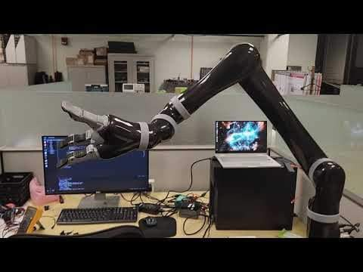
JACO VOICE COMMAND SCRIPT DEMO
DYNAMIC NETWORKS & CONTROL LABORATORY
6/5/23
17

Slide 18

NEW GUI - AUDIO ADDED
Made several quality-of-life improvements to program to make it more user- friendly and "seamless".
For the Audio components of the program:
Made new voice lines – chose a masculine voice for Jaco – I think it's amusing but not sure if users would appreciate it. It would be an easy change to generate new voice lines anyway.
Changed Wake Word to be "Hey Jaco" instead of "Hey Turtlebot"
Besides recreating the same voice lines I created for Turtlebot with Jaco's voice as well, I have made some more that I plan to implement in the future.
Added Jaco explaining his origins and purpose for a "tell me
about yourself" command
Added Jaco prompting the user for more info – specifically how far they want Jaco to move, and if no direction is given, what direction they want Jaco to move. Of course, moving incrementally will be added later.
Added some more extraneous voice lines that I may use
later, just fun comments by Jaco as easter eggs.
They are all in the audio folder but not used yet – need to re-train rhino model to add that functionality. Original model in the cloud is lost so I can no longer just add commands again.
6/8/23

Slide 19

NEW GUI - THREADING IMPROVEMENTS
Another very important change I made was to have the GUI and audio processing sections of the code run as separate threads.
The turtlebot script was command-line only because the GUI held up the rest of the code from running, even if they were in separate functions – I suspected this is just how Python logic worked so I needed a workaround
Remembered from senior design project that my CSE team members frequently used threading in their scripts to help separate functions in python scripts run concurrently. So I wanted to implement this.
So made the GUI its own function, and the PvPorcupine, PvRhino and PVRecorder modules into one big function
This allowed both to startup with no conflict. But I wanted the GUI to print Jaco's speech as well as the current status of the robot, and the current Joint States.
Was not finding many good tutorials on how to achieve this. Used ChatGPT to learn more – informed me of a threading module called an event, and a separate Python module known as a queue.
Queues would store data globally so separate threads can pass information along to each other
Events would allow functions to trigger functionalities in separate threads.
So, once the voice command triggered motion in Jaco, I added the necessary info to their own queues, and set events to active in the GUI – this would trigger the updating of information in real time
Once again the Jaco died before I could continue so I will work on this later.
6/8/23

Slide 20

PLANNED FEATURES
Features I wish to add in the future:
For now, I have to start the arm's launch file and the MoveIt! Launch file in two separate shells before running my script – can easily implement this to start up from my script – I had done it for the turtlebot.
I still have to make the GUI print the joint states in real time. This might not be feasible so I may have to settle for printing joint states once the movement finishes
Arm does not move incrementally right now – instead it follows macros I defined in the launch file using the MoveIt! setup assistant. I really wanted to use the cartesian planner but none of the functions made by kinova that use it seem to work. Not sure what the issue is there. Would have to log errors and communicate with Kinova to hopefully get a clue to fixing it
I plan to use the joint planner to move it incrementally for now – however, the movement may not be smooth. I want the end effector to move smoothly along a plane. For example if the user says "move forward" the end effector should move on –y direction only. I may have to hard code the kinematics myself. Though MoveIt! does have end effector control, perhaps there is something I can use to facilitate my desired movement
6/8/23

Slide 21

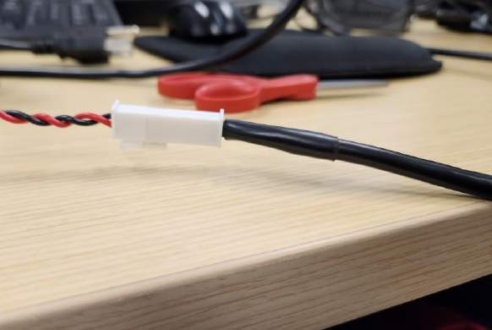
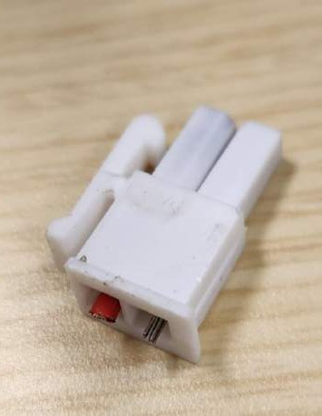
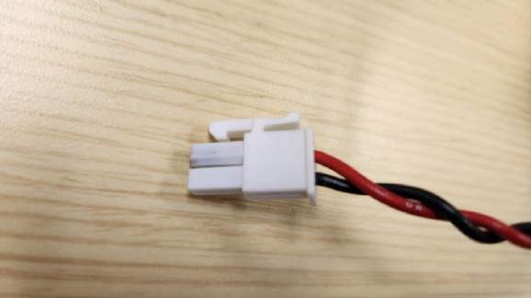
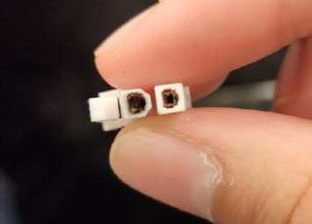
FIXED MELTED BATTERY CONNECTOR
Parts came in for battery connector, finally fixed it.
Was simple, though depleted battery still had ~20V left, had to be careful. Isolated terminals before working on it.
So far seems to charge normally.
Goes from 21 v to 26 v in about 2 hrs.
Did not want to deplete battery every time I use it since that can shorten battery life.
Inferred max battery charge capacity is 29.4 since
nominal voltage is 26 v. Assuming each cell is 3.7
V nominally, that would mean battery has 7 cells. Max would be 4.2 V each or 29.4 V total.
Min would be around 21 V which seems accurate from my experience.
Also asked ClearPath contact to be sure I am taking care
of battery correctly. Confirmed my math was correct.
Had to be careful not to short since battery still had 20 V left - a short may have caused the destruction of the previous connector
6/13/23
21

Slide 22
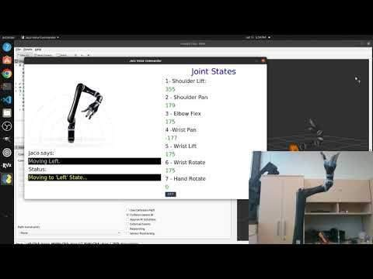

NEW GUI FUNCTIONALITY DEMO
DYNAMIC NETWORKS & CONTROL LABORATORY
6/13/23
22

Slide 23
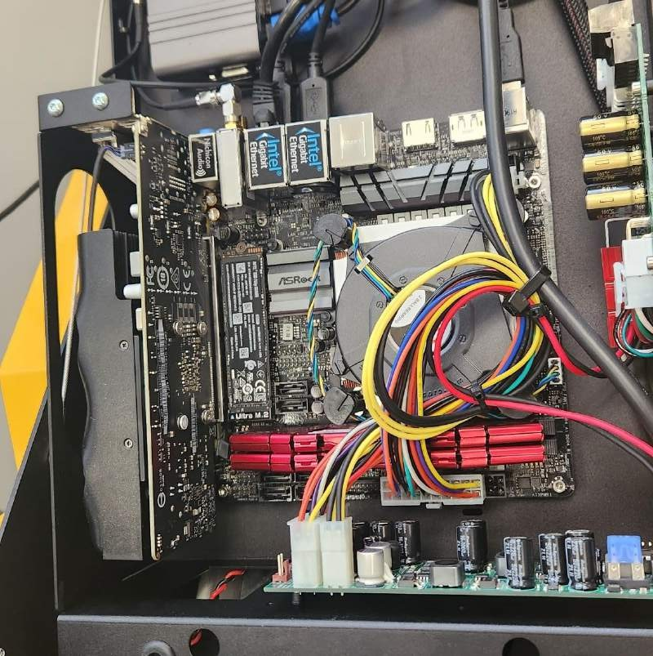
------SECTION TWO-------------------------
CONFIGURING THE JACKAL’S INTERNAL PC
6/15/23 - 7/18/23
Extending Voice
Control to Jaco
6/15/23
23

Slide 24

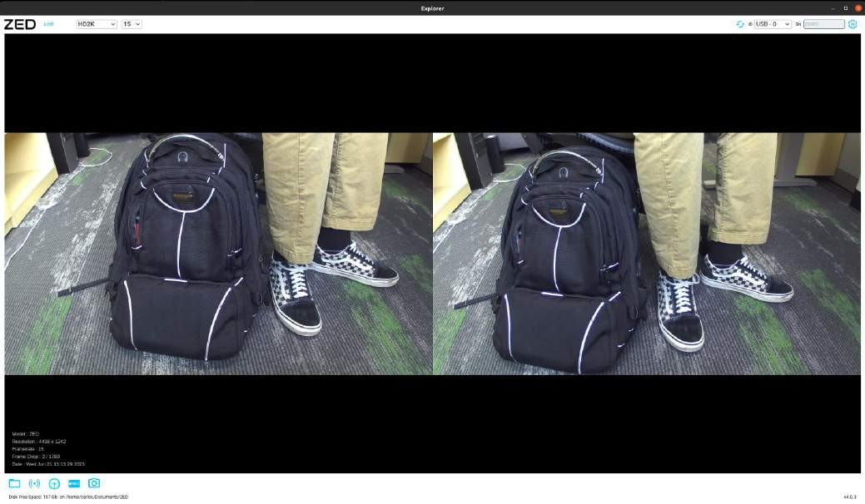
SETTING UP JACKAL FOR USE - PROBLEMS
Tried following the tutorial to set up jackal.
However PC seemed to not be on. Pinging it gave me an error saying the host server cannot be reached.
Going to try charging to full battery before trying again
Found Zed camera connection on SBC
Connected Zed camera directly to PC
Got SDK installed and it works correctly so far
Worried I won't be able to use the more advanced capabilities like point-cloud generation since apparently this is made for NVIDIA GPUs – my laptop has a Intel UHD 60 integrated graphics (not nearly as powerful, Quad core but it is about as powerful as entry level NVIDIA GPU – probably won't cut it for more complex operations. Was able to capture 4k video at 15fps, 1080p at 30, 720 at 60, and 480p at 100+ fps.
This supports my need to use the Jackal's on-board computer for image processing. Data stream seemed to be happening between computers, but I am not sure if it is a power issue yet
6/15/23
24

Slide 25

JACKAL INTERNAL COMPUTER AND MCU ISSUES
Spoke with Clearpath about issues. They asked for me to check:
Hostname & Serial No. Of Jackal
If voltage drops when attempting a power on
Check power on PC for Jackal
Check all MCU connections since this may be responsible for outage
Findings:
Voltage while off: 27.34 V
Voltage while on: 27.31 V (fluctuating between .34 and .32)
All connections seemed to be present
MCU turns on for a second then shuts off, sounds like a circuit breaking – perhaps I am triggering overvoltage protection since the battery is above 26 volts – I did not think this would be an issue but I have a hunch
Otherwise there may be a short or missing connection somewhere causing this erratic behavior –waiting on Clearpath's assistance.
6/17/23
DYNAMIC NETWORKS &
25
CONTROL LABORATORY

Slide 26

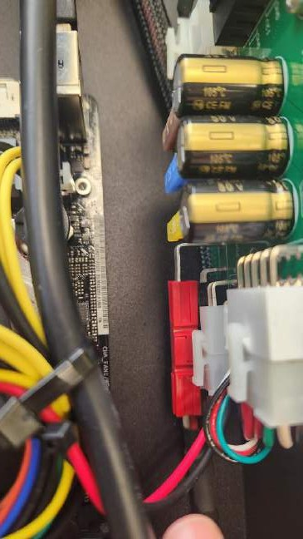
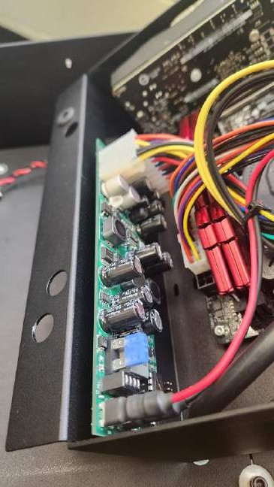
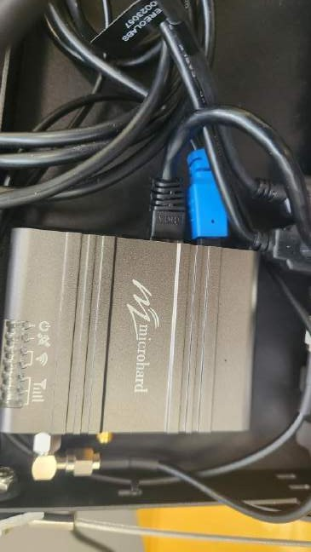
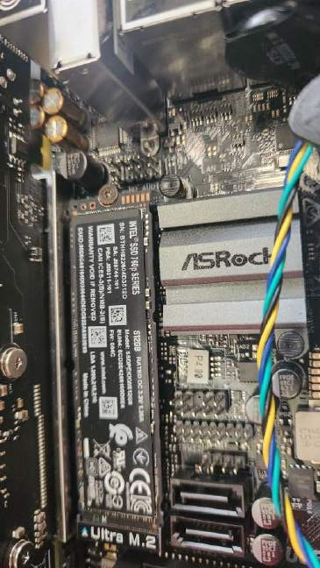
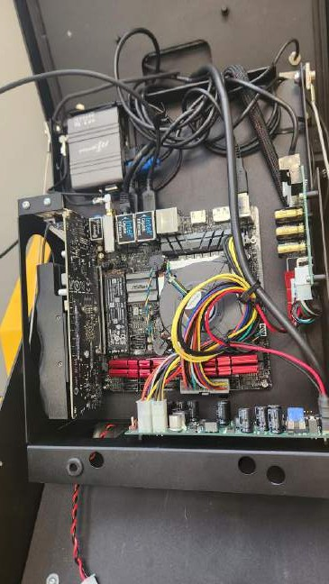
PICTURES OF INTERNAL PC COMPONENTS ON JACKAL
From left to right: (1) 1st PDB (2) 2nd PDB(3) Network module (4)motherboard GPU and SSD connections
(5)Zoomed out view of entire PC
6/17/23

Slide 27
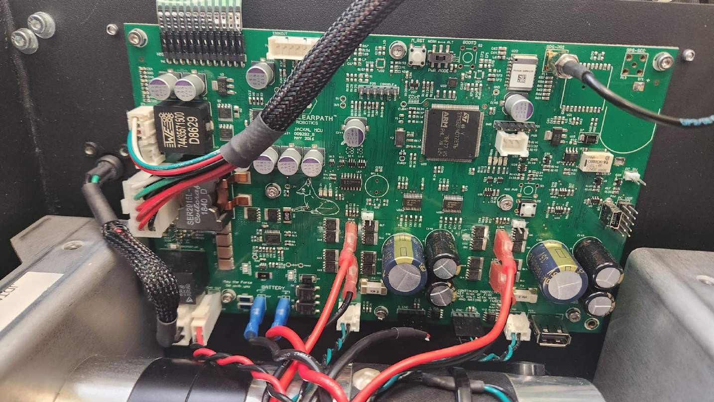
PICTURES OF CLEARPATH JACKAL MCU
6/17/23

Slide 28
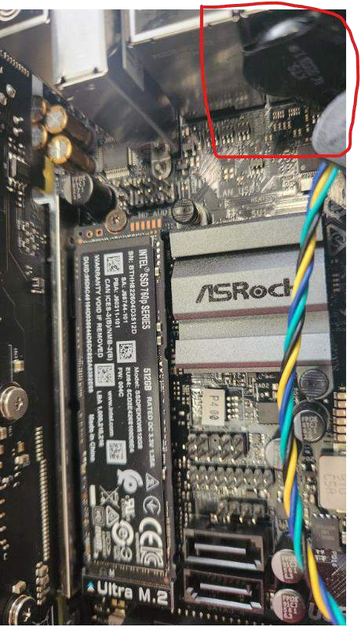
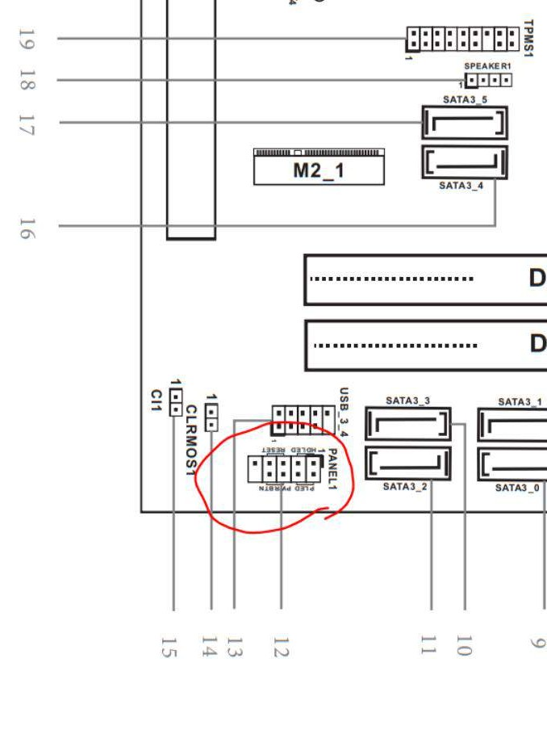
CLEARPATH SUPPORT UPDATE
The issue with the MCU was resolved by flipping the power mode switch.
However, the computer itself would still not turn on...
My ClearPath support agent, Rusty, suspects that the CMOS battery on the motherboard has died, meaning the BIOS firmware is unable to start up. (It's a basic CR2032)
He informed me that the default behavior for startup is that the computer powers on when power is detected. But with the BIOS inactive this cannot happen.
He also advised that shorting the PWRBTN pin and GND on the motherboard may allow me to turn it on.
6/17/23

Slide 29

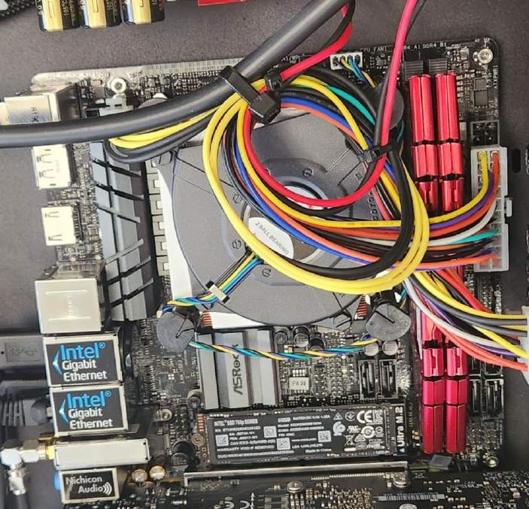
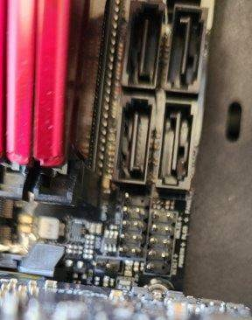
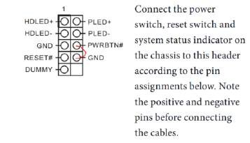
CLEARPATH SUPPORT UPDATE(2)
Panel 1 on the motherboard – if this is shorted the PC should power on
6/17/23

Slide 30
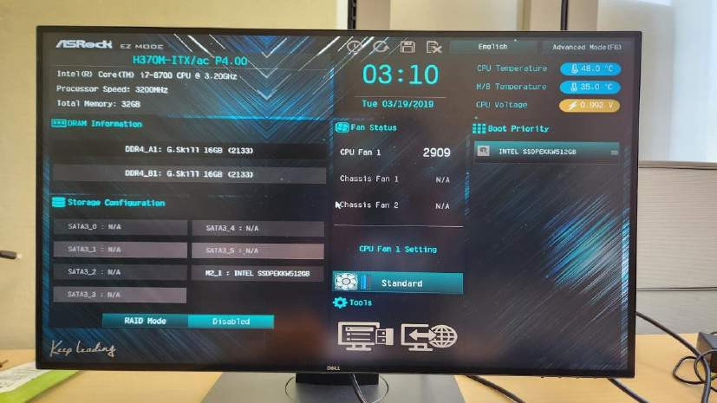
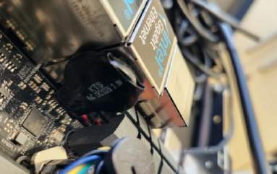
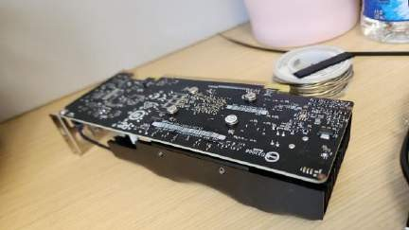
POWERING ON PC
Shorting the power pins indeed powered the
PC on.
However ethernet connection was still not operational – host could not be found
Decided to connect Jackal's PC to display directly. None of the HDMI ports worked.
Read that with inactive CMOS sensor, BIOS revert to default and changes cannot be saved
By default, BIOS selects motherboard's graphics card instead of GPU, but GPU connection disables motherboard's HDMI ports
Removed GPU, allowing display to be enabled on motherboard
6/17/23

Slide 31
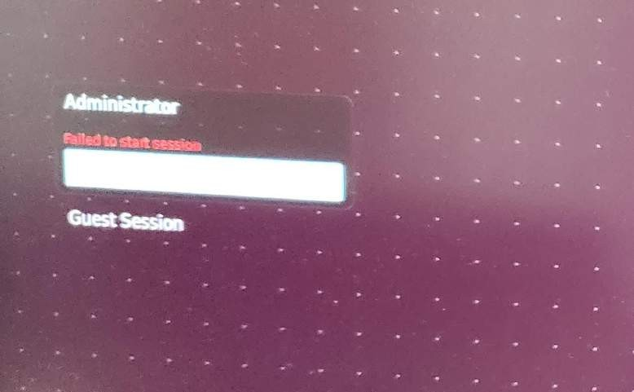
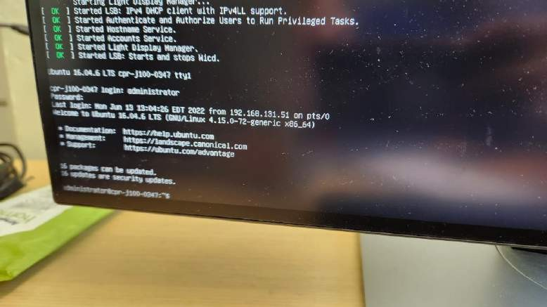
WI-FI SETUP ISSUES
Unfortunately after powering on new issues arose
On startup I can't log in to the computer, i get the error "failed to start session."
When switching to command line I can sign in but when trying to set up a wifi network with "wicd-curses" I get the error "bios contains wgds but no wrds."
The network is visible and I can input the password but it never connects
though connecting to the wifi router through ethernet seemed to work, still received the same error
May need to replace CMOS battery if BIOS aren't loading properly
Clearpath support suggested I use the base station to set up the jackal's network since it is programmed to immediately connect to it.
DYNAMIC NETWORKS & CONTROL LABORATORY
7/7/23
31

Slide 32

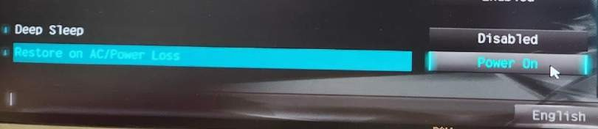
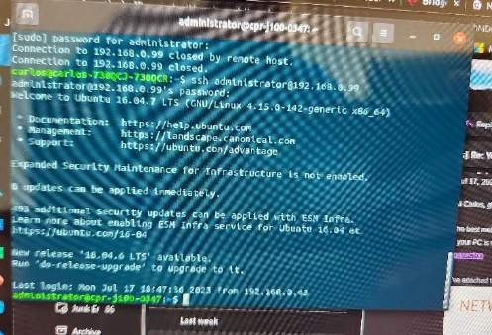
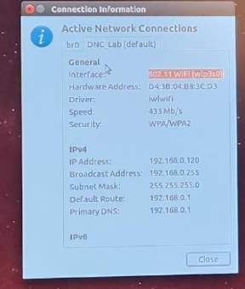
FINALLY GETTING THE PC WORKING
Finally replaced CMOS battery.
Unfortunately, BIOS were reset to default so I had to enable the setting that turns on the PC upon detection of power once again.
Doing that seems to have fixed the power issue, I no longer have to short the power switch pins to turn the PC on.
The sign-in error was likely due to the gnome installation being corrupted somehow.
To fix that I used the virtual terminal (Ctrl+Alt+F2) and connected the PC to the web through ethernet.
I reinstalled gnome which fixed the sign-in issue
I then had to reinstall language packs for the other
gnome features to be usable
After the CMOS battery was replaced I no longer received the wifi driver error either
Wifi connection on the internal PC seems a bit spotty. Can’t effectively download anything onto the machine on wifi but I can ssh into it wirelessly now, which was my goal all along.
Now I can set up the PC to use ROS
DYNAMIC NETWORKS &
CONTROL LABORATORY
7/18/23
32

Slide 33
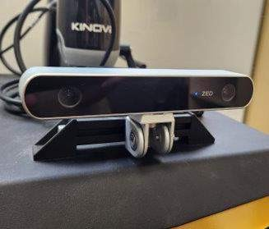
----SECTION THREE-------------------------
IMPLEMENTING COMPUTER VISION
7/19/23 - 8/29/23
Extending Voice
Control to Jaco
7/19/23
33

Slide 34

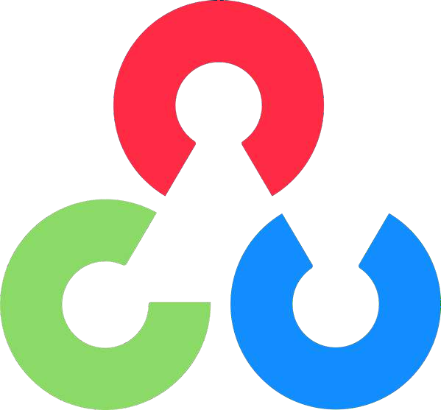

IMPLEMENTING COMPUTER VISION FOR OBJECT DETECTION
Don't have hands on experience with Computer Vision, but part of my senior design project did involve it –learned about OpenCV and You only look once (YOLO)
I want to use real-time object detection to facilitate use of the robot arm – OpenCV and
Internal PC has very good GPU, an SSD, etc, much more powerful than my laptop – should be able to use YOLO well
I want to train it to recognize everyday objects – bags, doorknobs, cups,
water bottles, etc. – things your hands would commonly be used for
The voice command method of control is not as easy to use as I had wanted. Would take a lot of tinkering to even get it to perform a simple task
Computer vision would make it a lot simpler for the end user and potentially myself as well
Kinova does have a computer vision module package on Github -
https://github.com/Kinovarobotics/ros_kortex_vision
However, I am not sure what infrastructure for the functionality I am envisioning exists already, or if it is all up to date.
The Jackal UGV seems to have Jaco arm and Zed camera modules installed already.
7/19/23

Slide 35

MY EXPERIENCE WITH OPENCV
Open source computer vision library – robust collection of CV algorithms
Integrates easily with Python – used for my senior design project for a drone to have QR code detection to identify a variety of vehicles and categorize them
OpenCV development was mostly handled by my team's smaller group of CSE Majors in Python – will ask them for advice and, also look back on our old research from that project to make its usage easier
To install I was following the official tutorial in
this link: https://pyimagesearch.com/2016/10/24/ubuntu-16-04-how-to- install-opencv/
Run into error when installing virtual environment (recommended for any OpenCV functions – my senior design project did the same)
Hit a wall here just like my teammates did and other senior design students also using computer vision did. Might need to reach out to solve the issue
If I remember correctly they had to freshly reinstall pip for OpenCV to be installed correctly but I am not sure
Turns out ROS full installation already came with OpenCV so I never needed to install it to begin with....
7/19/23

Slide 36
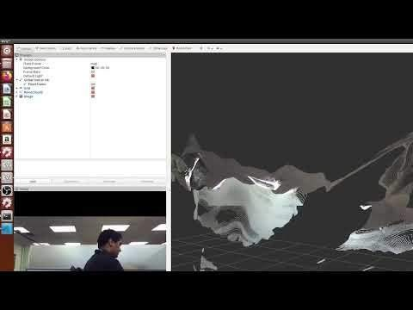
ZED STUDIO CAMERA – POINT CLOUD
Clearpath sent me the custom manual for the
UTARI ordered Jackal I have been using
Informed me that the Zed camera was all set up in ROS
Tried it out, seems to be working. I am not sure how accurate it is or how to use it in conjunction with motion planning just yet. I am also unsure of how to use object detection with it so Jaco arm can pick up objects and differentiate between objects
Upon further inspection the functionality I desire
may be possible out of the box.
7/19/23
36

Slide 37
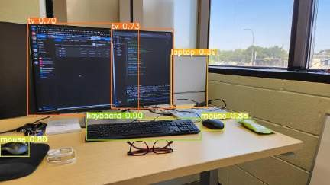
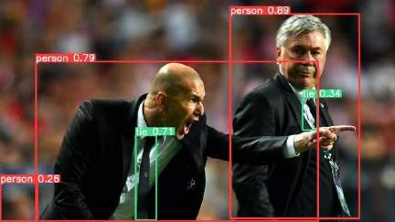
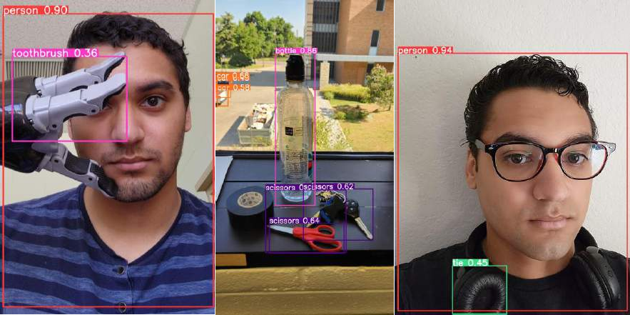
YOLO IMAGE OBJECT DETECTION TEST IN PYTHON
Installed YOLOv5 python module
Tested out various images to see extent of data it
comes pre trained with.
Can detect people and various objects
Will attempt to get arm to grab water bottle since that is one of the detectable items.
This is only detecting objects from pre obtained
images. Need various things:
Detect during a live video feed
(ZED may be able to do this natively)
Understand arm's position relative to the camera
(Will likely come from URDF file)
Integrate with arm's motion planning
(This may be the most difficult to implement if not already provided by the manufacturer)
7/24/23

Slide 38
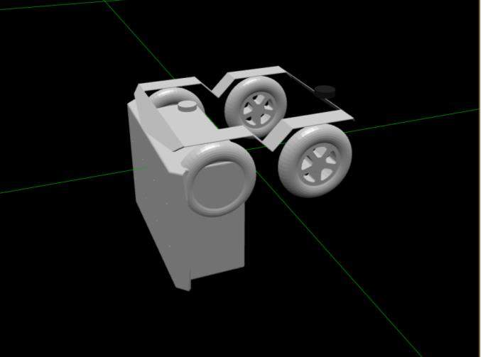
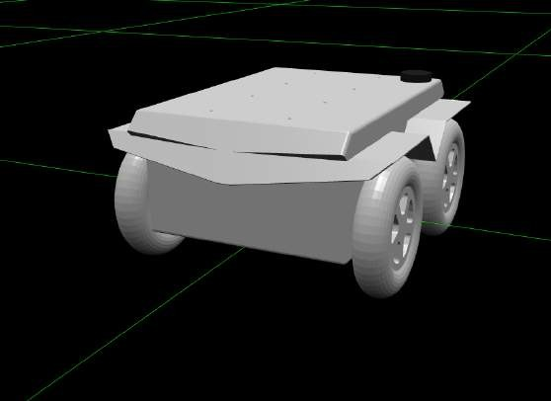
GATHERING UTARI10 JACKAL HARDWARE DESCRIPTION
Hardware description for UTARI10 Jackal not working
Loading it up in RViz gets me nothing, it seems topics are not
publishing correctly.
May need to create own hardware description from scratch.
Tried using VS code to view jackal URDF.
Got an error stating it could not find an accessory I didn't have.
Removed optional accessories inclusion command
<xacro:include filename="$(find jackal_description)/urdf/accessories.urdf.xacro" />
Loaded Jackal but body was in the wrong position
Changed rotation of y axis to pi/2, seemed to fix orientation
Now I just need to find out how to add the accessories to
the hardware description
Once that is done I should be able to implement object detection in MoveIt!
7/24/23

Slide 39

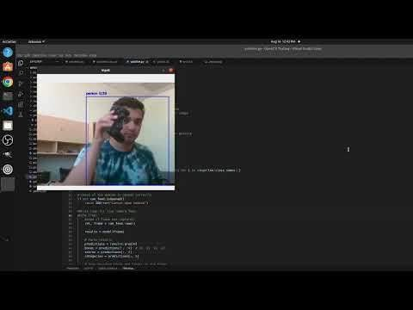
MOVING ON FROM JACKAL -COMPUTER VISION WITH LIVE FEED
Troubleshooting entire system that is no longer supported at my experience level is taking away too much time.
Going to attempt using only the arm and the zed camera to facilitate
the picking up of objects. Both interface with my laptop already.
Will still troubleshoot jackal with manufacturer in the background.
Using YOLOv5, numpy, and OpenCV, I was able to open the camera and obtain a live feed while YOLO analyzes each frame and outputs its recognized objects and confidence level, just like with the images.
Used default webcam to do this as a test.
There is latency of about 1 second due to the extra processing done
on each frame – various adjustments can reduce latency somewhat
YOLO confidence threshold and maximum number of detections are the biggest variables that affect playback
I require there is at least 50% confidence in each object inference for it to be displayed on screen, and keep detection attempts at 100 per image
Like before, I am using a default YOLO model, though I can train my own if I desire
A single camera is not able to do distance estimates, so I would like to extend this to the ZED camera
8/16/23

Slide 40
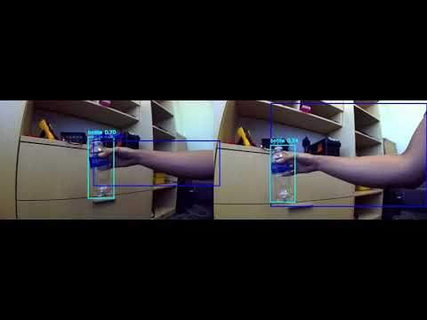
OBJECT DETECTION WITH LIVE FEED – ZED CAMERA
Unfortunately, the ZED SDK cannot be implemented
on my Laptop, it requires an NVIDIA GPU to function
However, I am still able to get both image streams by simply switching the device in OpenCV
The object detection seems to only really apply in the left camera output. Doesn't really impact performance from what I can tell. In fact, the ZED stereo camera has less latency than my webcam, likely because it can output much higher framerates at low resolutions
OpenCV does have its own way to create a depth map in Python:
First, I must gather the camera's specifications
Second, I must create a disparity map
Third, I must input disparity into a depth
reading
Finally, I must adjust and tune the depth reading to be more accurate
Once this depth mapping is implemented, I should be able to derive coordinates for the gripper to move to
8/16/23

Slide 41
DISPARITY MAP AND DEPTH MAP
Disparity can be calculated from the cv2.StereoSGBM class that OpenCV provides.
Since the ZED shows both lens feeds in one window, first we split the view in half.
Then, the image frame is transformed to black and white since disparity is more apparent without color.
Once the disparity is calculated, I filtered the frame with a Gaussian Blur function to remove outliers from the disparity calculation.
I also applied a disparity mask – basically a value to further limit the calculated disparity values. Right now I have it set to filter out disparities less than 50.
Depth is then calculated with the following formula:
BASELINE * FOCAL LENGTH / DISPARITY
Baseline is the distance between the centers of the ZED apertures – 120 mm
Focal length is the distance in mm between the optical center of the lenses and the cameras' sensors – 2.8mm - converted to pixels, it is 889 px
This depth then comes out in mm
Works, but values were constantly deviating and giving inaccurate values until
parameters were edited:
StereoSGBM has "number of disparities" set to 96 and a block size of 5
NumDisparities refers to the amount of disparity the program will recognize (96 levels) - any more levels and latency increases
BlockSize refers to the size of the partitions the frame is broken into when calculating disparities (5 is the smallest)
8/16/23

Slide 42
YOLOLIVE.PY - DISPARITY AND DEPTH MAP SCRIPT
import cv2
# While loop for live camera feed while True:
ret, frame = cam_feed.read()
# Draw bounding boxes and labels on the frame
for box, score, category in zip(boxes, scores, categories):
x1, y1, x2, y2 = map(int, box) c_x = int((x1 + x2) / 2)
c_y = int((y1 + y2) / 2)
import yolov5 import numpy as np
# Convert disparity to depth using calibration parameters
baseline = 120 # Replace with your camera's baseline (in mm)
focal_length = 889 # Replace with your camera's focal length (in pixels)
# Split the frame into left and right images height, width = frame.shape[0], frame.shape[1] left_img = frame[:, :width // 2]
right_img = frame[:, width // 2:]
disparity_roi = disparity[y1:y2, x1:x2] # Check if the disparity ROI is empty if disparity_roi.size == 0:
avg_disparity = 0 # Set a default value or handle empty case
else:
avg_disparity = np.mean(disparity_roi)
# load pretrained model
model = yolov5.load('yolov5s.pt') # set model parameters
model.conf = 0.50 # NMS confidence threshold model.iou = 0.45 # NMS IoU threshold model.agnostic = False # NMS class-agnostic
model.multi_label = False # NMS multiple labels per box model.max_det = 1000 # maximum number of detections per image
# Convert images to grayscale
left_gray = cv2.cvtColor(left_img, cv2.COLOR_BGR2GRAY) right_gray = cv2.cvtColor(right_img, cv2.COLOR_BGR2GRAY)
# Perform stereo matching (Block Matching) stereo = cv2.StereoSGBM_create( minDisparity=3, # Minimum disparity (default: 0)
numDisparities=16*6, # Number of disparities (must be a multiple of 16) blockSize=5, # Block size for matching (odd values between 5 and 255, default: 3) P1=8 * 3 * 5 ** 2, # Penalty term 1 (default: 8 * block_size^2)
P2=32 * 3 * 5 ** 2, # Penalty term 2 (default: 32 * block_size^2)
disp12MaxDiff=1, # Max allowed difference between disparities in images (default: 1) preFilterCap=63, # Pre-filter cap (default: 63)
uniquenessRatio=10, # Uniqueness ratio (default: 10) speckleWindowSize=100, # Speckle window size (default: 100) speckleRange=32 # Speckle range (default: 32)
# Convert disparity to depth
depth_value = (baseline * focal_length) / ( avg_disparity if avg_disparity != 0 else 0)
# Load class names
class_names = model.names
label = class_names[int(category)] color = class_colors[int(category)]
# Define color mapping based on YOLOv5's official color palette color_palette = [
(255, 0, 0), # Red
(0, 255, 0), # Green
(0, 0, 255), # Blue
(255, 255, 0), # Yellow
(0, 255, 255), # Cyan
(255, 0, 255) # Magenta
]
class_colors = {i: color_palette[i % len(color_palette)] for i in range(len(class_names))}
cv2.circle(frame, (c_x, c_y), 1, color, 2) cv2.rectangle(frame, (x1, y1), (x2, y2), color, 2) cv2.putText(frame, f'{label} {score:.2f}', (x1, y1 - 10), cv2.FONT_HERSHEY_SIMPLEX, 0.5, color, 2)
cv2.putText(frame, f'{depth_value:.2f} mm', (x1, y1 - 30), cv2.FONT_HERSHEY_SIMPLEX, 0.5, color, 2)
)
disparity = stereo.compute(left_gray, right_gray) # Apply Gaussian filtering to the disparity map disparity = cv2.GaussianBlur(disparity, (5, 5), 0)
# Avoid division by zero and small disparity values valid_disparity_mask = disparity > 50 # Adjust threshold as needed depth = np.zeros_like(disparity, dtype=float)
depth[valid_disparity_mask] = (baseline * focal_length) / disparity[valid_disparity_mask]
# Record the frame recording.write(frame)
# Create video capture feed object
cam_feed = cv2.VideoCapture(0)
# Display the disparity colormap, depth information, and input frame cv2.imshow('Disparity Colormap', disparity_colormap) cv2.imshow('Input with Depth', frame)
# Check if the webcam is opened correctly if not cam_feed.isOpened():
raise IOError("Cannot open webcam")
# Normalize disparity for visualization
normalized_disparity = cv2.normalize(disparity, None, alpha=0, beta=255, norm_type=cv2.NORM_MINMAX, dtype=cv2.CV_8U)
c = cv2.waitKey(1) if c == 27:
break
frame_width = int(cam_feed.get(3)) frame_height = int(cam_feed.get(4)) size = (frame_width, frame_height)
# Apply colormap for visualization
disparity_colormap = cv2.applyColorMap(normalized_disparity, cv2.COLORMAP_JET) # Perform object detection
results = model(frame) # Parse results
predictions = results.pred[0]
boxes = predictions[:, :4] # x1, y1, x2, y2
# Release resources cam_feed.release() recording.release() cv2.destroyAllWindows()
recording = cv2.VideoWriter('filename.avi', cv2.VideoWriter_fourcc(*'MJPG'),10, size)
DYNAMIC NETWORKS & CONTROL LABORATORY
scores = predictions[:, 4]
categories = predictions[:, 5]
8/16/23

Slide 43
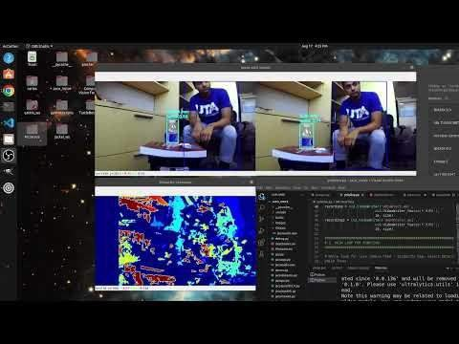
DISPARITY COLORMAP DEMO
6/18/23

Slide 44
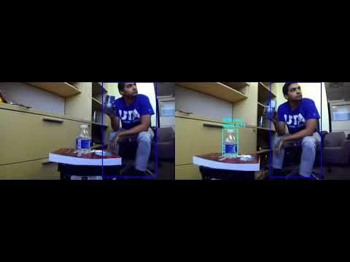
DISTANCE ESTIMATE AND DEPTH MAPPING DEMO
6/18/23

Slide 45

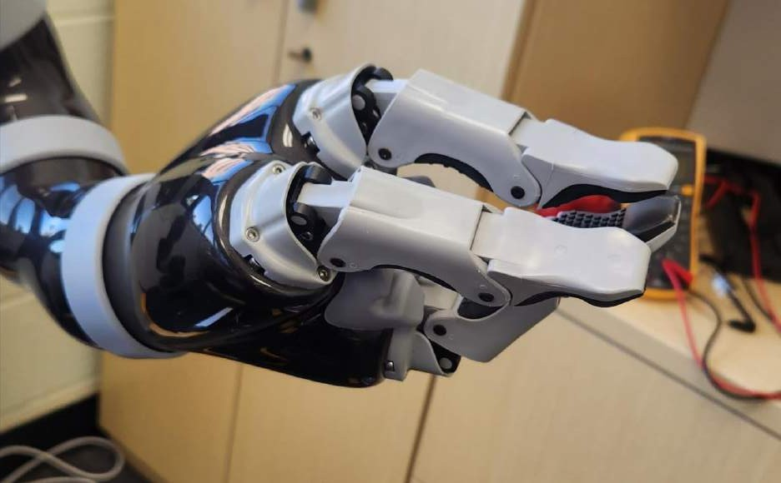
MOVEIT_ COMMANDER CARTESIAN ORIENTATION
+θx
PITCH +θy
+θz
8/18/23
45

Slide 46

MOVEIT_ COMMANDER CARTESIAN CONTROL REVISITED
+Z
My difficulties with this controller earlier were because I kept giving it coordinates that are out of its bounds.
(0,0,~0.88…)
Now I have experimented with the provided jaco controller to empirically denote its cartesian limits, or at least limits within my normal expected range of operation
(~0.88…,0,0)
-X
(0,~0.88…,0)
+Y
Limits are provided to the right. Now I need to denote the orientation value, which is written in quarternions –which I am not familiar with
(0,0,0)
Luckily the tf module in python lets me transform euler angles (roll, pitch, yaw) to quarternions – much more intuitive so I will be converting between these units
-Y
-Z
+X
(0,~-0.88…,0)
(~0.88…,0,0)
(0,0,~-0.48…)
6/18/23
46

Slide 47

TRANSFORMING FROM CAMERA TO REAL-WORLD COORDS.
Transforming from the camera coordinates to "real world" coordinates requires knowledge of camera parameters that will be used in our calculations
Intrinsic Parameters: parameters related to the internal construction and properties of the camera
To get coordinate (x,y,z) from pixel coordinates (xp,yp):
Where:
<fx,fy> is the focal length
<cx,cy> are the principal points
d is the depth calculated
from our depth map
Focal length(F) – how strongly a lens converges light
Principal Points(C) – where the center of the image intersects with the lens center
Radial Distortion(R)- warping of the image caused by lens curvature imperfections
Tangential Distortion(T)- translations/ rotations in the image due to
imperfect lens placement in a camera
Extrinsic Parameters: parameters related to the camera's position in the world coordinates
Translational Matrix – deals with translations from 3D world to 2D image
Rotational Matrix – deals with rotations from 3D world to 2D image
Can be derived from calibrating camera using OpenCV test images
Luckily, ZED has already done that and provides the parameters for me
Work for converting coordinates is shown on the right
DYNAMIC NETWORKS & CONTROL LABORATORY
8/18/23
47

Slide 48
ZED STEREO CAMERA INTRINSIC & EXTRINSIC PARAMETERS
INTRINSIC PARAMETERS
Focal Length
EXTRINSIC PARAMETERS
Stereo:
Translational Matrix:
T = [120.001, 0.00497035, 0.00734397 ]
Rotational Matrix:
R = [0.0129092, 0, 0.000353473]
Left Camera: Right Camera:
• F =[350.2575, 350.2575] • F = [ 349.805 , 349.805]
Principal Points
Right Camera:
Left Camera:
C=[322.1425, 176.3005]
C=[321.7375, 190.71825]
Radial Distortion Coefficients
Left Camera:
RD=[322.1425, 176.3005]
Right Camera:
RD=[321.7375, 190.71825]
Tangential Distortion Coefficients
Left Camera: Right Camera:
• TD=[322.1425, 176.3005] • TD=[321.7375, 190.71825]
8/18/23
48

Slide 49

CREATING CONSTRAINTS FOR THE ARM’S MOTION PLANS
Running YOLOlive.py for the first time, the jaco arm successfully moved towards the detected water bottle, but collided with the Zed camera and Jackal Chassis.
This is something I want to avoid to prevent damage to the platform and the arm's motors.
Moveit_commander does allow me to set constraints – regions that the motion planner will avoid when called.
This did not work as expected, instead it was simply unable to plan a path in the alloted time.
May need more accuracy in camera feed.
Will attempt to use Jackal PC to install Zed camera SDK for depth mapping and motion planning.
8/20/23
49

Slide 50

----SECTION FOUR--------------------------
ADDING FUNCTIONALITY TO FULL ROBOT
8/29/23 - 11/25/23
Extending Voice
Control to Jaco
DYNAMIC NETWORKS & CONTROL LABORATORY
50

Slide 51


CLEANING UP WORKSPACE
I suspected my catkin workspace was not properly built, leading to errors.
Wiped workspace clean.
Made sure to download packages from their respective ROS kinetic branches.
Rebuilding workspace, Jackal /odom topic does not exist.
Changing frame to base_link (jackal's chassis) showed static links, but did not show any links related to moving joints.
Added joint-state-publisher to launch file and links were properly displayed. However, control was still not possible. I am certain many topics are still missing regarding motor trajectory, odometry, and other essential functions – rostopic list command only showed the transforms and joint publisher started by RViz
DYNAMIC NETWORKS & CONTROL LABORATORY
8/30/23
51

Slide 52





JACKAL CONTROL SOLUTION
After speaking with Clearpath Support again, I was informed that the Jackal's MCU was not communicating with ROS on the internal PC – as shown by the jackal's HMI "connection" light being off
Disconnected and Reconnected PC and MCU
Hit Reset button on MCU
Ran these commands:
No connection with
MCU, Wi-Fi not Enabled.
Sudo ros-stop
Sudo ros-start
This immediately started all the topics that were missing previously. The Jackal
Visualization loaded correctly and showed all
peripherals
Twist controller once again became usable!
Connected to MCU, Wi-Fi
Enabled!
DYNAMIC NETWORKS &
8/30/23
CONTROL LABORATORY

Slide 53

ZED PYTHON API ON PC
My laptop is no longer adequate for this project's development.
While it has 12 GB RAM, 512 GB SSD, and a 10th Generation Intel i7 CPU, it lacks an NVIDIA graphics card.
A required dependency of the ZED camera's SDK and Python API is to have CUDA – allowing NVIDIA GPUs to be used for general purpose processing beyond computer graphics – (like for example depth mapping!) . Can't use this without an NVIDIA GPU unfortunately.
Luckily, the DNC Lab had an available PC with an NVIDIA GPU on it with Ubuntu. However, during setup several issues were encountered:
I was unable to log in since PC used SecureDoc. Even after my profile was added it was not recognizing my sign in. Eventually the DSA was able to have a fresh install of Ubuntu 20.04 Focal Fossa without needing that securedoc sign in (deprecated OpSec Encryption UTA used)
I should now be able to port my workspace and python scripts over to the PC to continue development
Installed ROS, ZED SDK, and the Zed Python API on the PC. Have yet to use it but I should be able to obtain a much better and more accurate depth map with its capabilities, which should improve the path planning algorithm's accuracy.
DYNAMIC NETWORKS &
8/31/23
CONTROL LABORATORY

Slide 54

JACKAL CONTROL SOLUTION(2)
I was able to move the Jackal with the twist controller loaded in RVIZ, meaning I could possibly extend control with the camera and arm as well.
Tried using the DualShock4 Controller included by ClearPath
to control the Jackal - however bluetooth connection does not work.
The DS4 is manufactured by Sony originally for use with their PlayStation 4 game consoles. There is no official support in Ubuntu, especially not an EOL distro like 16.04 Xenial Xerus, currently on the Jackal.
In Ubuntu 20.04 Focal Fossa, there is bluetooth support out of the
box
However in 16.04, it is not recognizing the DS4 controller through bluetooth.
Bluetooth is also not enabled in GNOME GUI but can be accessed through the terminal package bluetoothctl. Using this still does not provide Bluetooth capability. - May need to install gnome-bluetooth
There are unofficial drivers called ds4drv that should help connect DS4s but they are unable to detect any controller. I tried three separate DS4s and none are recognized.
The DS4 can teleop the Jackal when connected by USB, but this is impractical for obvious reasons.
Turns out there were conflicting versions of the bluetooth driver installed that were causing errors in the Ubuntu system. Once one was removed bluetooth worked once again and I was able to wirelessly teleop.
8/30/23
54

Slide 55

NEW DESK ENVIRONMENT
Along with the new PC at my new desk, I have found several pieces of equipment that could be very useful.
External charger for Jackal. The manual mentioned that an external charger could be connected so removing the battery for charging would not be necessary. This adapter was at my new desk all along.
Also at this new desk was a power adapter for the Kinova Jaco2 arm. This means it can be used without needing to have the Jackal Powered on. This combined with the new Zed SDK and Python API on the PC means I can develop the computer vision aspect of the project completely independently of the Jackal if needed.
I can also successfully SSH into the Jackal's computer and source its ROS master to control the Jackal from the PC.
Can also potentially teleop with bluetooth controller from this PC if ROS Master URI is sourced.
I am unsure if having differing versions of ROS affects its operation. If so, could potentially use docker to have kinetic
8/31/23
55

Slide 56
ZED PYTHON API ON JACKAL
Installing the ZED Python API on the jackal was not as straightforward as on PC.
Issues mainly stemmed from 16.04 only being compatible with older versions of the Zed Python API.
I was able to install it from source. However, I encountered other issues:
OpenCV version is pulled from Python 2.7 installation that comes by default with ROS Kinetic. Had to add extra lines
in script to source Python 3.8 installation instead.
Attributes of some classes are not recognized in VS Code despite me being able to import the libraries after source installation – could be that the most recent docs have had syntax and name changes - however using the docs generated with the source install also does not pull up the proper installation. Perhaps it is pulling the wrong zed python API as well?
Needs more research. If this can be done from the PC base station internal install of API may not be necessary.
Camera can steam wirelessly to client, but updates are very slow. Might be better to run script on the jackal itself.
Zed API for ubuntu 16 is deprecated. Documentation and sample scripts do not provide an accurate list of objects and attributes – need to find correct version.
Zed Python API depth mapping sample script was provided by stereolabs on their GitHub.
It seems to work much more accurately than my own script. I will modify my voice command script to use this API instead. Also noticed depth detection performance tapers off if distance was less than ~702mm away
This could explain the wild errors I was receiving in my initial depth mapping tests with my own script I created with
OpenCV's disparity map.
8/30/23
56

Slide 57

WI-FI CONNECTIVITY ISSUES - SOLUTION
Have been having network issues on the Jackal.
Clearpath states that NetworkManager could be interfering with Wicd. Will try removing network- manager and running wicd alone.
This did not help. Behavior was the same.
Found the culprit of connectivity issues –
Microhard radio had a VLAN network, also
named “DNC_Lab”
I had inadvertently created this months ago during my initial troubleshooting.
Deleting this allowed the Jackal to find the “real” DNC_Lab Wi-Fi network to enable connectivity.
After this I was able to connect!
SSH was functional and I could source the ROS Master on the jackal as well. I could successfully run the teleop visualization module.
DYNAMIC NETWORKS & CONTROL LABORATORY
8/30/23
57

Slide 58

INSTALLING UBUNTU 20.04 ON JACKAL
Due to the issues with the Zed Python API and other problems encountered with Ubuntu 16.04, I have decided to update the Ubuntu distro on the Jackal to version 20.04, and the ROS version to ROS Noetic.
Luckily Clearpath has made a thorough tutorial
here: https://www.clearpathrobotics.com/assets/guides/kinetic/kinetic-to- melodic/index.html
First I will back up all the necessary files and configurations currently on the Jackal for a smooth transition to Ubuntu 20.04 and ROS Noetic without losing my work thus far
Second I will install a custom Ubuntu image for the Jackal Clearpath has created.
This custom image had issues during installation so I did a clean install instead.
Finally, I will restore the backup's files and installations. The script provided by
clearpath should replace deprecated packages with their Focal/Noetic equivalents.
The restore script did not work as intended so I had to manually reinstall all the necessary programs. Works well except the issue of the hardware description not loading correctly is happening again. It shows the default jackal description on startup, but when the arm is brought up it "overwrites" the jackal's model. Since it has no IMU's on it, the transform does not work correctly leading to the errors displayed earlier. I still have the utari10-jackal
.urdf that adds on the camera and arm onto the jackal's URDF but it does not load by default
8/30/23

Slide 59
ROBOT_UPSTART AND UDEV RULES
Due to not being able to port jackal installation as intended by clearpath, I had to use the package robot_upstart myself to start the jackal’s
drivers on startup
This package takes a launch file and creates a system service that runs on startup
I also created a startup service for the kinova arm
Received errors when starting up the kinova arm and the jackal at the same time
Added utari10_jackal extension to jackal’s .urdf file
However, this did not fix startup issues.
Looked at TF tree for both.
There was no transform from the jackal to the arm. Instead the arm was in its own transform tree – therefore loading the joint model caused errors for the arm.
Turns out a joint was missing between the jackal’s base and the arm’s base. Without this the TF tree cannot connect the two models
together.
Now that they are linked in my new launch file, the drivers all load together, however, their MoveIt launch files do not reflect the new model.
Turns out I can’t use their predefined launch files supplied by the creators – both assume that their individual robots are
standalone, so each one loads a “robot-description” topic that overrides the other.
Ran MoveIt Setup Assistant to set up the proper config files so I can make my own joint moveit launch file. I only really need moveit for the arm’s joint states since the jackal has a differential drive wheel system. So the moveit launch file for the arm just needs to load the arm’s controllers with the jackal’s model.
8/30/23

Slide 60
REVAMPING ROBOT PERSONALITY AND RHINO CONTEXT
Jackal and Jaco sound way too similar, I will instead make his new name: J.A.C.K.S.O.N.
J - Joint
A - Assisted
C - voice-Controlled
K – kinematic
S - System
O - Operated by
N - Neural Networks
I will relegate Jackal section to "wheels" and Kinova arm section to "arm"
This will make them distinct enough while giving voice commands so they won't get misidentified when analyzing user speech
Rewrote Picovoice Rhino Context:
Can now directly ask arm and jackal to move in cartesian directions and to turn based on an angle.
User will have to use centimeter units for cartesian direction and degree units for angle direction.
Acceptable cartesian directions are up, down, left , right, forward, and back for arm, and only forward and back for the jackal.
Turning directions are left or right for both the arm and jackal.
Added separate commands for gripper open and close.
Added command to trigger object detection for finding bottle.
Added general information that Jackson can state for user benefit, such as camera info, arm info , and jackal info.
8/30/23

Slide 61

IMPLEMENTING ZED PYTHON API INTO INITIAL SCRIPT
I found that the Zed camera's depth calculation was at times very inaccurate in the Python API. It would only sometimes gather the correct depth.
However, visualizing the point cloud let me discover several facts about the depth sensing:
My script does indeed pick depth at the point drawn at the center of the box as per my design.
I had assumed that the depth map would detect the entire bottle every time. However, visualizing the depth map in RViz demonstrates that only parts of the bottle are detected at the edge. Likely the most opaque parts of the bottle. This could be because the bottle is transparent and therefore the initial disparity map conflates most of the bottle with the background.
So, when I pick the center dot's coordinates it actually picks a depth way behind where the bottle is
I reached out to Stereolabs support for assistance in depth sensing.
They suggested the background scene had too many objects that are rectangular and uniform – depth mapping struggles with such surfaces and performs better on uneven, “natural” terrain – which is a bad fit if the robot is supposed to be an indoor assistant. This makes sense since the Jackal was primarily manufactured for outdoor expeditions in rough terrain.
8/30/23

Slide 62

FIXING ZED PYTHON API & OBJECT DETECTION
Several changes lead to marked performance improvements in using the ZED Python API for Depth Detection:
Depth mode was changed from ULTRA to PERFORMANCE mode. This not only reduces memory needed to run but also does not lead to as many "gaps" in depth readings due to lower resolution of point cloud. May not be as accurate for mapping purposes, but for object detection this performance is preferable.
Depth Confidence intervals were also increased to further reduce gaps in point cloud. Accuracy of depth data does not need to be as fine in an indoor scene due to the many elements that impact the accuracy of depth readings, including but not limited to:
Large, flat, geometric shapes
Light sources and their reflections in objects
Smooth objects
Transparent or translucent objects
As a result, using the maximum power of the ZED camera indoors leads to many areas where the algorithm was unable to calculate depth. Increasing the confidence interval meant that even lower confidence values created by irregularities were accepted, leading to a more complete depth map.
To further improve performance, object detection is now not a continuous function but only runs once at the current frame of the camera loop when it is called, reducing memory usage even more – which leads to better performance and more accuracy in object detection overall.
8/30/23

Slide 63
NEW PROGRAM STRUCTURE
Due to growing complexity of the program, I have opted to separate each functions into specific classes located in separate modules. This structure by itself should have no impact on performance but makes readability and debugging much easier
The modules are as follows:
zedcam.py
contains the ZedCam class that initializes the camera and contains the camera loop and detection methods
yolodetect.py
contains the Yolo_Obj class that initializes YOLOv5 and contains the object detection method that zedcam.py uses
robotmove.py
contains the RobotMove class that initializes the moveit_commander objects for the arm and gripper and methods for specifying directions and sending motion plans for both the Jaco arm and the Jackal
picovoicer.py
contains the PicoVoicer class which initializes the picovoice objects and contains methods for performing
a RobotMove action depending on the specific voice command recognized
voiceline.py
contains the VoiceLine class which contains all the methods for playing audio lines when needed. Used in both the main script ros_voicer.py and picovoicer.py when a specific audio file needs to be played
ros_voicer.py
main script that joins them all together
Runs the PicoVoicer.audio_processing() and ZedCam.camloop() functions as threads, and starts the ROS node that
publishes to the Twist topic for the Jackal's movement commands.
8/30/23

Slide 64

FIXING LAUNCH FILES FOR UTARI10-JACKAL
Trying to use the already created launch files for the Jackal and the Kinova arm created problems with the transform tree – they both generated their own robot state publishers and joint state publisher nodes in their own namespaces
This meant when the move_group node was launched it did not receive the full state or the robot's joints, only the ones that were published directly to the /joint_states topic were publishing to move_group (usually it was the jackal node that did this while the kinova arm's nodes published on a completely different topic altogether in its own namespace)
To fix this, I had to edit the launch files for the jackal and the kinova arm to stop them from creating their own separate robot state and joint state publisher nodes
Once this was done, I instead started the nodes in a separate launch file, and then instantiated a single robot_state node for the combined robot – this publishes the correct transform tree all from one node and also routes the separate joint states for the arm and the jackal to the
/joint_states topic – giving move_group the complete state of the robot as needed.
I then configured rviz to show the pieces I was interested in showing:
The MotionPlanner display for the arm is visible so users can motion plan for the arm and gripper section of the robot
The interactive twist marker server is present to move the jackal using RVIZ
The fixed frame is changed to the odometer topic /odom to receive the robot's
orientation and space
Now the robot should plan to move the arm while avoiding collisions with its own body parts including the jackal and zed camera mounts.
8/30/23

Slide 65

DEBUGGING SCRIPT
Trying my new script for the first time of course had issues that I needed to fix.
robotmove.py:
Added new method for publishing twist messages to Jackal and Kinova Arm
for smooth control
Removed all moveit_commander objects, am now using the arm's built-in IK planner due to it's built-in constraints and ability to plan around singularities
Added 'duration' as an additional argument to twist message publisher function
For arm cartesian movement (like for object detection) , direction commands are now added to current coordinates instead of being absolute cartesian coordinates for the arm
Additional print statements for debugging
ros_voicer.py:
Robot now moves arm to home position upon initialization
picovoicer.py:
Converted integer input values from strings to floating point numbers
For distance inputs, units were converted from centimeters to meters
Fixed detection of slots for specific intents in picovoice rhino array
Changed pvrecorder device index to always pick the default device
8/30/23

Slide 66

----SECTION FIVE---------------------------
COMPLETED PLATFORM DEMO
11/26/23 - 12/2/23
Extending Voice
Control to Jaco
11/26/23
66

Slide 67

ROS_VOICER PACKAGE DEMO
11/28/23

Slide 68

ROS_VOICER PACKAGE DEMO 2
11/28/23

Slide 69
CURRENT LIMITATIONS
ISSUES
SOLUTIONS
Currently no way to interrupt an action besides the physical stop buttons or ROS services
Voice command only understands two-digit integers, meaning it will not understand decimals or integers above 99
Recording freezes whenever Jaco speaks, meaning internal video feed is desynchronized from external recordings
Need to be near jackal to give it voice commands
since microphone is physically on the chassis
Jackal does not plan around obstacles
Program flags in the script to trigger stop services for all motors
Re-train model to accept floating point numbers with higher amount of digits
Insert blank frames when recording is paused or cut off recording when it is interrupted
run script on base station computer so microphone is always close to the user, use wireless mic for higher range
Implement SLAM with camera + lidar combo
11/28/23

Slide 70
THANK YOU!
SPECIAL THANKS TO:
DR. YAN WAN, DISTINGUISHED UNIVERSITY PROFESSOR, ELECTRICAL ENGINEERING JIAJIAN CHANG, PH. D. STUDENT
BINOY GEORGE , MASTER'S STUDENT
DYNAMIC NETWORKS &
₇₀CONTROL LABORATORY

Slide 71

REFERENCES
“Benefits Of Jaco Robotic Arm On Independent Living And Social Participation: An Exploratory Study,” RESNA Annual Conference - 2014, 2014. [Online]. Available: https://www.resna.org/sites/default/files/conference/2014/Robotics/Routhier.html. [Accessed: 23-Oct-2022].
E. Biddiss, P. McKeever, S. Lindsay, and T. Chau, “Implications of prosthesis funding structures on the use of prostheses,” Prosthetics & Orthotics International, vol. 35, no. 2, pp. 215–224,
2011.
[3]. R. AppelDoorn, “picovoice_ros: ROS Wrappers for the Picovoice libraries,” GitHub. [Online]. Available: https://github.com/reinzor/picovoice_ros. [Accessed: 2- May-2023].
Picovoice, Inc., “Porcupine Wake Word Python Quick Start," picovoice.ai. https://picovoice.ai/docs/quick-start/porcupine-python/(accessed May 2, 2023).
Picovoice, Inc., “Rhino Speech-to-Intent Python Quick Start," picovoice.ai. https://picovoice.ai/docs/quick-start/porcupine-python/(accessed May 2, 2023).
Jaco assistive robot User guide,Kinova Robotics, Boisbriand, Quebec, Canada. [Online]. Available: https://assistive.kinovarobotics.com/uploads/EN-UG-007-Jaco-user-guide- R05.pdf[Accessed: 14-Feb-2023].
PickNik Robotics, “Move Group Python Interface,"
docs.ros.org. https://docs.ros.org/en/kinetic/api/moveit_tutorials/html/doc/move_group_python_interface/move_group_python_interface_tutorial.html(accessed May 2, 2023).
Jocher, G. (2020). YOLOv5 by Ultralytics (Version 7.0) [Computer software]. https://doi.org/10.5281/zenodo.3908559
Kinova Robotics, “kinova-ros,” GitHub.[Online]. Inc.,Available: https://github.com/Kinovarobotics/kinova-ros (accessed Oct 11, 2023)
Clearpath Robotics, “Jackal User Manual,” Clearpath Robotics. Available: https://docs.clearpathrobotics.com/docs/robots/outdoor_robots/jackal/user_manual_jackal/ (Accessed Dec 5, 2023).
Stereolabs, “Stereolabs Docs: API Reference, Tutorials, and Integration,” Stereolabs, Inc. Available: https://docs.stereolabs.com/ (Accessed Nov 8, 2023).
DYNAMIC NETWORKS &
₇₀CONTROL LABORATORY

Slide 72
VOICE-COMMAND ACTIVATION OF JACO2 THROUGH ROS & PYTHON
Carlos Mella-Rijo Department of Electrical Engineering The University of Texas at Arlington
2023
DYNAMIC NETWORKS & CONTROL LABORATORY

Slide 73
PROJECT GOALS
I have already achieved voice control of another robotic arm, the TurtleBot 2i's PhantomX Pincher 5DOF arm. This project aims to be an extension of the former. Instead of a robot arm used as a learning tool, this functionality will be applied to an industrial grade arm so it may better fulfill its original purpose of aiding the motor impaired in an easier fashion than a joystick could. First the existing functionality will be applied to the new robot, then further improvements will be made for a seamless simple user experience that the voice commanded arm will be a benefit to users in everyday life.
DYNAMIC NETWORKS & CONTROL LABORATORY
5/15/2023
73

Slide 74

------SECTION ONE-------------------------
CREATING VOICE CONTROL FOR JACO ARM
Extending Voice
Control to Jaco
5/15/23 - 6/15/23
DYNAMIC NETWORKS &
74
CONTROL LABORATORY

Slide 75
CLEARPATH JACKAL AND KINOVA JACO2
Provided Clearpath Robotics' Jackal UGV
Comes with Kinova Jaco2
arm
Jackal can provide power and data connections to the arm
For now, I am directly going to control the arm through USB to my Ubuntu laptop
Jackal has its own computer that could possibly be used for full control of the entire robot later
DYNAMIC NETWORKS & CONTROL LABORATORY
5/15/2023
75

Slide 76
JOYSTICK MOVEMENT
Wanted to test Jaco's joints
before proceeding
Fixed Jaco2 upon ClearPath Jackal mount
No way to power it besides Jackal power plug
Battery seems to have charge – found charger in Kinova case
Controller connects to separate port in the back – all joints seem to
work correctly except for the "thumb" joint – though I may have just missed how to move it so far
DYNAMIC NETWORKS & CONTROL LABORATORY
5/25/23
76

Slide 77
JOINT ACTION CLIENT MOVEMENT
Next step was to connect to PC
Takes USB2.0 type b connection
Downloaded kinova_ros packages
Built in separate workspace jaco_ws
Read Github readme – tried starting up Jaco
Some issues sprang up when trying to use it:
Had to edit launch file
for jaco : kinova_robot.launch
xacro.py is deprecated in noetic – had to edit out any instances of this being called. - replace with just "xacro" to
call xacro
Scripts seem to be written in python2 – had to update syntax to be usable with my installation – for example, the
"joints_action_client.py" script
Motion works differently
for jaco than with turtlebot_arm
Joint angle states published are
added to current position of arm instead of it being set to a fixed position measured by degrees
Ex. Publishing 10 deg to joint 2 which is at 10 deg will make it move to 20 deg
5/25/23

Slide 78
PLANNING POTENTIAL APP FEATURES
This behavior of joint action client moving a set relative distance changes how the code will operate:
Will need to specify quantities of movement when giving commands
Need to make commands translate seamlessly from colloquial
language
For example, I don't want user to say "move up in x radians"
Need to have compound movements be as simple as possible – don't want client to have to move every motor individually – was tedious enough with joystick
There is a cartesian action client that moves the end effector in
cartesian units of meters – solves all three problems
This also means that the speech recognition library will need to be extended
Also debating on whether to use a GUI or not
Voice gives more than enough feedback to user esp. If software is
headless like for example on a chair mount
Terminal should be able to help with debugging if necessary
However, GUI could provide a clearer status of what the arm is doing – could inlcude RViz and RQT somehow
5/25/23

Slide 79
FIGURING OUT CONTROL
Was trying out different ways to control the arm. Was having difficulties.
Did figure out some commands.
Command to return to home: "rosservice call /j2n6s300_driver/in/home_arm"
Command to use the JointVelocity message format:
rostopic pub -r
100 /j2n6s300_driver/in/joint_velocity kinova_msgs/JointVelocity "{joint1
: 0.0, joint2: 0.0, joint3: 0.0, joint4: 0.0, joint5: 0.0, joint6: 10.0}"
Cartesian control is proving difficult.
Cartesian command output topic is: /j2n6s300_driver/out/cartesian_command
Kinova states that "Cartesian position control can be realized by
calling KinovaComm::setCartesianPosition() in customized node."
Not sure how to use this yet. Opted to use included clients instead.
There are several python-based clients included that help facilitate motion: pose_action_client.py and joint_action_client.py
“Pose” takes inputs of cartesian position (x,y,z) relative to base link and quarternions for rotation ( x, y, z, w)
Refers specifically to location of end effector
“Joints” takes radian or degree inputs for each specific joint
They both add the values input by the user to the current values of the joints/positions. Will need their limits to not go over what motors can achieve. Jaco should have built in limits to prevent this, however pose action client would often not publish new inputs after first use. Suspect it might be taking the
5/29/23
79

Slide 80
BATTERY DAMAGE
Batteries ran out before completing basic script – charger is broken – one of the pins in the battery’s charging port is melted and deformed
After searching for the correct connector online, decided to contact ClearPath, they gave me the correct listings on digikey:
Molex Connector: MiniFit Jr 5557
https://www.digikey.ca/en/products/ detail/molex/0039013028/2405392
Pins: 0457501211
https://www.digikey.ca/en/products/
detail/molex/0457501211/2404781
Parts were ordered but can't really use arm without battery since I have no other compatible connector
5/29/23
80

Slide 81
CHARGING WITH MELTED PORT
Spare parts were ordered to fix battery connector
In the meantime, it turns out there was sufficient contact with the broken connector to charge the battery while pressure is applied – reinforced with electrical tape so battery can charge.
Charger is not made for battery, and there is no indicator or shut off that I know of, so I must keep watch on it to make sure it does not exceed the charge capacity
Only way to check is to measure the voltage with a meter – easy to do since the charging connector is separate from the main prongs
The battery is Li-Ion
Nominal voltage is 26v, unsure what the peak charge capacity is – so will stop charging when it is at 26 v – check it every 5 minutes
Should hopefully only have to do this once while the parts are in transit
6/1/23

Slide 82
USING MOVEIT! SUCCESSFULLY
Tested out action clients, did not like how cumbersome they were
Tried out MoveIt! Once again and worked much better than before
Finally allows for easy way to
create compound movements.
Otherwise I would have had to deal with quarternions to send cartesian commands to Jaco.
"roslaunch j2n6s300_moveit_config j2n6s300_demo.launch"
6/1/23

Slide 83
JACO ARM CARTESIAN DIRECTIONS
From kinova_ros readme:
The Cartesian coordinate of robot root frame is defined by the following rules:
origin is the intersection point of the bottom plane of the base and cylinder center line.
•+x axis is directing to the left when facing the base panel (where power switch and cable socket locate).
•+y axis is towards to user when facing
the base panel.
•+z axis is upwards when robot is standing on a flat surface.
+Z
-X
+Y
-Y
-Z
+X
DYNAMIC NETWORKS & CONTROL LABORATORY
6/1/23
83

Slide 84
JACO ARM ROTATION DIRECTIONS
Arrows indicate direction of positive increment of radians
Joint 1:
Limits: [0 to 360]
Joint 2:
Limits: [47 deg to 313 deg]
Joint 3:
Limits: [19 deg to 341 deg]
Joint 4:
Limits: [0 to 360]
Joint 5:
Limits: [0 to 360]
Joint 6:
Limits: [0 to 360]
DYNAMIC NETWORKS & CONTROL LABORATORY
6/1/23
84

Slide 85
MOVEIT_COMMANDER TEST SCRIPT
import sys import rospy
import moveit_commander import faulthandler
With moveit_commander I was able to publish joint states directly to the robot – makes things a lot easier than the action clients
Can use this to facilitate voice command since the execution of the function can be tied to an event
Publishing joint states directly worked very well.
In MoveIt, I had set up custom poses with the set up client
Works Perfectly
faulthandler.enable() rospy.init_node('foo', anonymous=False) roscpp_initialize(sys.argv)
group_name = 'arm'
move_group = moveit_commander.MoveGroupCommander(group_name)
# gripper move_group2 group2_name = 'gripper'
move_group2 = moveit_commander.MoveGroupCommander(group2_name) move_group2.set_max_velocity_scaling_factor(1.0) move_group.set_max_velocity_scaling_factor(1.0)
joint_angles = [1, 1, 1, 1, 1, 1] # Replace with the desired joint angles move_group.set_joint_value_target(joint_angles)
# Set the named target state
named_target = "Vertical" # Replace with the name of the desired preset state move_group.set_named_target(named_target)
print("moving to pose 3...")
plan = move_group.go(wait=True) print("Finished!!!!!")
named_target2 = "Open" move_group2.set_named_target(named_target2) print("Opening Gripper...")
plan = move_group2.go(wait=True) print("Finished!!!!!")
named_target2 = "Close" move_group2.set_named_target(named_target2) print("Closing Gripper...")
plan = move_group2.go(wait=True) print("Finished!!!!!")
DYNAMIC NETWORKS &
6/1/23
CONTROL LABORATORY

Slide 86
JACO VOICE COMMAND SCRIPT
#! /usr/bin/env python #!/usr/bin/python -tt
# Printing Module Versions and Context information for clarity print('Porcupine version: %s' % porcupine.version) print('Rhino version: %s' % rhino.version)
print('Context info: %s' % rhino.context_info)
import os, struct, wave, pvporcupine, pvrhino, rospy, subprocess, faulthandler, threading
from datetime import datetime from pvrecorder import PvRecorder from std_msgs.msg import Float64 import numpy as np
from playsound import playsound as ps import tkinter as tk
from tkinter import *
from termcolor import colored import moveit_commander
# Creating and starting Recorder Instance
recorder = PvRecorder(device_index=5, frame_length=porcupine.frame_length)
# Parses keywords from porcupine keywords = list()
for x in keyword_paths:
keyword_phrase_part = os.path.basename(x).replace('.ppn', '').split('_') if len(keyword_phrase_part) > 6:
keywords.append(' '.join(keyword_phrase_part[0:-6])) else:
keywords.append(keyword_phrase_part[0])
#jacoapp.py - Main Script for Voice Control
# jointrad function, similar to turtlebot arm's but uses moveit_commander instead
def jointrad(armstate):
armstate = armstate arm.set_named_target(armstate) plan = arm.go(wait=True)
# Creates a wav file to store audio stream while in use wav_file = wave.open('wave.wav', "w") wav_file.setnchannels(1)
wav_file.setsampwidth(2) wav_file.setframerate(16000)
#ROS node that will publish states to MoveIt! rospy.init_node('JacoVoicer', anonymous=False)
# Instantiating Arm Group group_name = 'arm'
arm = moveit_commander.MoveGroupCommander(group_name) arm.set_max_velocity_scaling_factor(1.0)
# Enables 'faulthandler' - dumps Python tracebacks explicitly, on a fault, after a timeout, or on a user signal.
faulthandler.enable()
if name == ' main ':
try:
#Startup Sound - anything with ps is just playing the .wav files in the Audio folder. Also
made the terminal print out what turtlebot says. ps("bootup.wav")
print(colored('TURTLEBOT SAYS:','blue')+" Hello There!") print(colored('TURTLEBOT SAYS:','blue')+" I am Jaco the Arm.") print(colored('TURTLEBOT SAYS:','blue')+"I'm Listening...")
# Instantiating Hand Group
group2_name = 'gripper'
gripper = moveit_commander.MoveGroupCommander(group2_name) gripper.set_max_velocity_scaling_factor(1.0)
# declaring args for picovoice modules before using them
access_key = '2saeQ0pr4C5VaUWzNDyGAM3vUMli/zt6efotQubsLICInVRXZCRWOA=='# Required Picovoice Access Key keyword_paths = ['~/Desktop/Picovoice/Porcupine/Hey-Turtle-bot.ppn'] # Porcupine .ppn file path context_path = "/home/carlos/Desktop/Picovoice/Rhino/Arm.rhn" # Rhino .rhn file path
# Allows us to see selected audio device - can be changed with args print('Using device: %s' %recorder.selected_device)
# Creating Porcupine wake word engine and Rhino speech-to-intent engine instances porcupine = pvporcupine.create(access_key=access_key,keyword_paths=keyword_paths) rhino = pvrhino.create(access_key=access_key,context_path=context_path)
# Let client know script is currently listening print('Listening ... (press Ctrl+C to exit)')
6/5/23

Slide 87
JACO VOICE COMMAND SCRIPT (2)
print("Moving to 'Home'State...") armstate = 'Vertical' jointrad(armstate)
if inference.intent == 'move':
#move to Up state
if direction =='up': armstate = 'Vertical'
print(colored('TURTLEBOT SAYS:','blue')+" Moving Up.") rospy.loginfo("Moving to 'UP' state...") jointrad(armstate)
#move to Down state elif direction =='down':
armstate = 'Down'
print(colored('TURTLEBOT SAYS:','blue')+" Moving Up.") rospy.loginfo("Moving to 'UP' state...") jointrad(armstate)
#move to Left state
elif direction =='left':
armstate = 'Left'
print(colored('TURTLEBOT SAYS:','blue')+" Moving Up.") rospy.loginfo("Moving to 'UP' state...") jointrad(armstate)
print(colored('TURTLEBOT SAYS:','blue')+"I'm Listening...") recorder.start()
while True:
#make recorder parse speech from wave.wav pcm = recorder.read()
# Both Rhino and Porcupine are made to process it.
result = porcupine.process(pcm) is_finalized = rhino.process(pcm)
# storing wav data in array if wav_file is not None:
wav_file.writeframes(struct.pack("h" * len(pcm), *pcm))
# if wakeword is detected, stop and move to neutral if result >= 0:
recorder.stop()
print('[%s] Detected %s' % (str(datetime.now()), keywords[result])) print("Moving to 'Home'State...")
armstate = 'Vertical' jointrad(armstate)
print(colored('TURTLEBOT SAYS:','blue')+"I'm Listening...") recorder.start()
#move to Right state elif direction =='right':
armstate = 'Right'
print(colored('TURTLEBOT SAYS:','blue')+" Moving Up.") rospy.loginfo("Moving to 'UP' state...") jointrad(armstate)
else:
pass
#start recorder to continue listening. recorder.start()
if is_finalized:
inference = rhino.get_inference()
if inference.is_understood:
print(" intent : '%s'" % inference.intent) for slot, value in inference.slots.items(): print(" %s : '%s'" % (slot, value))
direction = value
if inference.intent == 'shutdown': recorder.stop()
print(colored('TURTLEBOT SAYS:','blue')+"Shutting Down. Goodbye!") exit(0)
#stop recorder to prevent overflow error recorder.stop()
except KeyboardInterrupt: print('Stopping ...') finally:
recorder.delete() porcupine.delete() rhino.delete()
if wav_file is not None: wav_file.close()
6/5/23

Slide 88
JACO VOICE COMMAND SCRIPT DEMO
DYNAMIC NETWORKS & CONTROL LABORATORY
6/5/23
88

Slide 89
NEW GUI - AUDIO ADDED
Made several quality-of-life improvements to program to make it more user- friendly and "seamless".
For the Audio components of the program:
Made new voice lines – chose a masculine voice for Jaco – I think it's amusing but not sure if users would appreciate it. It would be an easy change to generate new voice lines anyway.
Changed Wake Word to be "Hey Jaco" instead of "Hey Turtlebot"
Besides recreating the same voice lines I created for Turtlebot with Jaco's voice as well, I have made some more that I plan to implement in the future.
Added Jaco explaining his origins and purpose for a "tell me
about yourself" command
Added Jaco prompting the user for more info – specifically how far they want Jaco to move, and if no direction is given, what direction they want Jaco to move. Of course, moving incrementally will be added later.
Added some more extraneous voice lines that I may use
later, just fun comments by Jaco as easter eggs.
They are all in the audio folder but not used yet – need to re-train rhino model to add that functionality. Original model in the cloud is lost so I can no longer just add commands again.
6/8/23

Slide 90
NEW GUI - THREADING IMPROVEMENTS
Another very important change I made was to have the GUI and audio processing sections of the code run as separate threads.
The turtlebot script was command-line only because the GUI held up the rest of the code from running, even if they were in separate functions – I suspected this is just how Python logic worked so I needed a workaround
Remembered from senior design project that my CSE team members frequently used threading in their scripts to help separate functions in python scripts run concurrently. So I wanted to implement this.
So made the GUI its own function, and the PvPorcupine, PvRhino and PVRecorder modules into one big function
This allowed both to startup with no conflict. But I wanted the GUI to print Jaco's speech as well as the current status of the robot, and the current Joint States.
Was not finding many good tutorials on how to achieve this. Used ChatGPT to learn more – informed me of a threading module called an event, and a separate Python module known as a queue.
Queues would store data globally so separate threads can pass information along to each other
Events would allow functions to trigger functionalities in separate threads.
So, once the voice command triggered motion in Jaco, I added the necessary info to their own queues, and set events to active in the GUI – this would trigger the updating of information in real time
Once again the Jaco died before I could continue so I will work on this later.
6/8/23

Slide 91
PLANNED FEATURES
Features I wish to add in the future:
For now, I have to start the arm's launch file and the MoveIt! Launch file in two separate shells before running my script – can easily implement this to start up from my script – I had done it for the turtlebot.
I still have to make the GUI print the joint states in real time. This might not be feasible so I may have to settle for printing joint states once the movement finishes
Arm does not move incrementally right now – instead it follows macros I defined in the launch file using the MoveIt! setup assistant. I really wanted to use the cartesian planner but none of the functions made by kinova that use it seem to work. Not sure what the issue is there. Would have to log errors and communicate with Kinova to hopefully get a clue to fixing it
I plan to use the joint planner to move it incrementally for now – however, the movement may not be smooth. I want the end effector to move smoothly along a plane. For example if the user says "move forward" the end effector should move on –y direction only. I may have to hard code the kinematics myself. Though MoveIt! does have end effector control, perhaps there is something I can use to facilitate my desired movement
6/8/23

Slide 92
FIXED MELTED BATTERY CONNECTOR
Parts came in for battery connector, finally fixed it.
Was simple, though depleted battery still had ~20V left, had to be careful. Isolated terminals before working on it.
So far seems to charge normally.
Goes from 21 v to 26 v in about 2 hrs.
Did not want to deplete battery every time I use it since that can shorten battery life.
Inferred max battery charge capacity is 29.4 since
nominal voltage is 26 v. Assuming each cell is 3.7
V nominally, that would mean battery has 7 cells. Max would be 4.2 V each or 29.4 V total.
Min would be around 21 V which seems accurate from my experience.
Also asked ClearPath contact to be sure I am taking care
of battery correctly. Confirmed my math was correct.
Had to be careful not to short since battery still had 20 V left - a short may have caused the destruction of the previous connector
6/13/23
92

Slide 93
NEW GUI FUNCTIONALITY DEMO
DYNAMIC NETWORKS & CONTROL LABORATORY
6/13/23
93

Slide 94
------SECTION TWO-------------------------
CONFIGURING THE JACKAL’S INTERNAL PC
6/15/23 - 7/18/23
Extending Voice
Control to Jaco
6/15/23
94

Slide 95
SETTING UP JACKAL FOR USE - PROBLEMS
Tried following the tutorial to set up jackal.
However PC seemed to not be on. Pinging it gave me an error saying the host server cannot be reached.
Going to try charging to full battery before trying again
Found Zed camera connection on SBC
Connected Zed camera directly to PC
Got SDK installed and it works correctly so far
Worried I won't be able to use the more advanced capabilities like point-cloud generation since apparently this is made for NVIDIA GPUs – my laptop has a Intel UHD 60 integrated graphics (not nearly as powerful, Quad core but it is about as powerful as entry level NVIDIA GPU – probably won't cut it for more complex operations. Was able to capture 4k video at 15fps, 1080p at 30, 720 at 60, and 480p at 100+ fps.
This supports my need to use the Jackal's on-board computer for image processing. Data stream seemed to be happening between computers, but I am not sure if it is a power issue yet
6/15/23
95

Slide 96
JACKAL INTERNAL COMPUTER AND MCU ISSUES
Spoke with Clearpath about issues. They asked for me to check:
Hostname & Serial No. Of Jackal
If voltage drops when attempting a power on
Check power on PC for Jackal
Check all MCU connections since this may be responsible for outage
Findings:
Voltage while off: 27.34 V
Voltage while on: 27.31 V (fluctuating between .34 and .32)
All connections seemed to be present
MCU turns on for a second then shuts off, sounds like a circuit breaking – perhaps I am triggering overvoltage protection since the battery is above 26 volts – I did not think this would be an issue but I have a hunch
Otherwise there may be a short or missing connection somewhere causing this erratic behavior –waiting on Clearpath's assistance.
6/17/23
DYNAMIC NETWORKS &
96
CONTROL LABORATORY

Slide 97
PICTURES OF INTERNAL PC COMPONENTS ON JACKAL
From left to right: (1) 1st PDB (2) 2nd PDB(3) Network module (4)motherboard GPU and SSD connections
(5)Zoomed out view of entire PC
6/17/23

Slide 98
PICTURES OF CLEARPATH JACKAL MCU
6/17/23

Slide 99
CLEARPATH SUPPORT UPDATE
The issue with the MCU was resolved by flipping the power mode switch.
However, the computer itself would still not turn on...
My ClearPath support agent, Rusty, suspects that the CMOS battery on the motherboard has died, meaning the BIOS firmware is unable to start up. (It's a basic CR2032)
He informed me that the default behavior for startup is that the computer powers on when power is detected. But with the BIOS inactive this cannot happen.
He also advised that shorting the PWRBTN pin and GND on the motherboard may allow me to turn it on.
6/17/23

Slide 100
CLEARPATH SUPPORT UPDATE(2)
Panel 1 on the motherboard – if this is shorted the PC should power on
DYNAMIC NETWORKS &
6/22/23
10
CONTROL LABORATORY
0

Slide 101
POWERING ON PC
Shorting the power pins indeed powered the
PC on.
However ethernet connection was still not operational – host could not be found
Decided to connect Jackal's PC to display directly. None of the HDMI ports worked.
Read that with inactive CMOS sensor, BIOS revert to default and changes cannot be saved
By default, BIOS selects motherboard's graphics card instead of GPU, but GPU connection disables motherboard's HDMI ports
Removed GPU, allowing display to be enabled on motherboard
DYNAMIC NETWORKS &
7/7/23
10
CONTROL LABORATORY

Slide 102
WI-FI SETUP ISSUES
Unfortunately after powering on new issues arose
On startup I can't log in to the computer, i get the error "failed to start session."
When switching to command line I can sign in but when trying to set up a wifi network with "wicd-curses" I get the error "bios contains wgds but no wrds."
The network is visible and I can input the password but it never connects
though connecting to the wifi router through ethernet seemed to work, still received the same error
May need to replace CMOS battery if BIOS aren't loading properly
Clearpath support suggested I use the base station to set up the jackal's network since it is programmed to immediately connect to it.
DYNAMIC NETWORKS & CONTROL LABORATORY
7/7/23
10

Slide 103
FINALLY GETTING THE PC WORKING
Finally replaced CMOS battery.
Unfortunately, BIOS were reset to default so I had to enable the setting that turns on the PC upon detection of power once again.
Doing that seems to have fixed the power issue, I no longer have to short the power switch pins to turn the PC on.
The sign-in error was likely due to the gnome installation being corrupted somehow.
To fix that I used the virtual terminal (Ctrl+Alt+F2) and connected the PC to the web through ethernet.
I reinstalled gnome which fixed the sign-in issue
I then had to reinstall language packs for the other
gnome features to be usable
After the CMOS battery was replaced I no longer received the wifi driver error either
Wifi connection on the internal PC seems a bit spotty. Can’t effectively download anything onto the machine on wifi but I can ssh into it wirelessly now, which was my goal all along.
Now I can set up the PC to use ROS
DYNAMIC NETWORKS &
CONTROL LABORATORY
7/18/23
10

Slide 104
----SECTION THREE-------------------------
IMPLEMENTING COMPUTER VISION
7/19/23 - 8/29/23
Extending Voice
Control to Jaco
DYNAMIC NETWORKS & CONTROL LABORATORY
7/19/23
10
4

Slide 105
IMPLEMENTING COMPUTER VISION FOR OBJECT DETECTION
Don't have hands on experience with Computer Vision, but part of my senior design project did involve it –learned about OpenCV and You only look once (YOLO)
I want to use real-time object detection to facilitate use of the robot arm – OpenCV and
Internal PC has very good GPU, an SSD, etc, much more powerful than my laptop – should be able to use YOLO well
I want to train it to recognize everyday objects – bags, doorknobs, cups,
water bottles, etc. – things your hands would commonly be used for
The voice command method of control is not as easy to use as I had wanted. Would take a lot of tinkering to even get it to perform a simple task
Computer vision would make it a lot simpler for the end user and potentially myself as well
Kinova does have a computer vision module package on Github -
https://github.com/Kinovarobotics/ros_kortex_vision
However, I am not sure what infrastructure for the functionality I am envisioning exists already, or if it is all up to date.
The Jackal UGV seems to have Jaco arm and Zed camera modules installed already.
7/19/23

Slide 106
MY EXPERIENCE WITH OPENCV
Open source computer vision library – robust collection of CV algorithms
Integrates easily with Python – used for my senior design project for a drone to have QR code detection to identify a variety of vehicles and categorize them
OpenCV development was mostly handled by my team's smaller group of CSE Majors in Python – will ask them for advice and, also look back on our old research from that project to make its usage easier
To install I was following the official tutorial in
this link: https://pyimagesearch.com/2016/10/24/ubuntu-16-04-how-to- install-opencv/
Run into error when installing virtual environment (recommended for any OpenCV functions – my senior design project did the same)
Hit a wall here just like my teammates did and other senior design students also using computer vision did. Might need to reach out to solve the issue
If I remember correctly they had to freshly reinstall pip for OpenCV to be installed correctly but I am not sure
Turns out ROS full installation already came with OpenCV so I never needed to install it to begin with....
7/19/23

Slide 107
ZED STUDIO CAMERA – POINT CLOUD
Clearpath sent me the custom manual for the
UTARI ordered Jackal I have been using
Informed me that the Zed camera was all set up in ROS
Tried it out, seems to be working. I am not sure how accurate it is or how to use it in conjunction with motion planning just yet. I am also unsure of how to use object detection with it so Jaco arm can pick up objects and differentiate between objects
Upon further inspection the functionality I desire
may be possible out of the box.
7/19/23

Slide 108
YOLO IMAGE OBJECT DETECTION TEST IN PYTHON
Installed YOLOv5 python module
Tested out various images to see extent of data it
comes pre trained with.
Can detect people and various objects
Will attempt to get arm to grab water bottle since that is one of the detectable items.
This is only detecting objects from pre obtained
images. Need various things:
Detect during a live video feed
(ZED may be able to do this natively)
Understand arm's position relative to the camera
(Will likely come from URDF file)
Integrate with arm's motion planning
(This may be the most difficult to implement if not already provided by the manufacturer)
7/19/23

Slide 109
GATHERING UTARI10 JACKAL HARDWARE DESCRIPTION
Hardware description for UTARI10 Jackal not working
Loading it up in RViz gets me nothing, it seems topics are not
publishing correctly.
May need to create own hardware description from scratch.
Tried using VS code to view jackal URDF.
Got an error stating it could not find an accessory I didn't have.
Removed optional accessories inclusion command
<xacro:include filename="$(find jackal_description)/urdf/accessories.urdf.xacro" />
Loaded Jackal but body was in the wrong position
Changed rotation of y axis to pi/2, seemed to fix orientation
Now I just need to find out how to add the accessories to
the hardware description
Once that is done I should be able to implement object detection in MoveIt!
7/19/23

Slide 110
MOVING ON FROM JACKAL -COMPUTER VISION WITH LIVE FEED
Troubleshooting entire system that is no longer supported at my experience level is taking away too much time.
Going to attempt using only the arm and the zed camera to facilitate
the picking up of objects. Both interface with my laptop already.
Will still troubleshoot jackal with manufacturer in the background.
Using YOLOv5, numpy, and OpenCV, I was able to open the camera and obtain a live feed while YOLO analyzes each frame and outputs its recognized objects and confidence level, just like with the images.
Used default webcam to do this as a test.
There is latency of about 1 second due to the extra processing done
on each frame – various adjustments can reduce latency somewhat
YOLO confidence threshold and maximum number of detections are the biggest variables that affect playback
I require there is at least 50% confidence in each object inference for it to be displayed on screen, and keep detection attempts at 100 per image
Like before, I am using a default YOLO model, though I can train my own if I desire
A single camera is not able to do distance estimates, so I would like to extend this to the ZED camera
8/16/23
11
0

Slide 111
OBJECT DETECTION WITH LIVE FEED – ZED CAMERA
Unfortunately, the ZED SDK cannot be implemented
on my Laptop, it requires an NVIDIA GPU to function
However, I am still able to get both image streams by simply switching the device in OpenCV
The object detection seems to only really apply in the left camera output. Doesn't really impact performance from what I can tell. In fact, the ZED stereo camera has less latency than my webcam, likely because it can output much higher framerates at low resolutions
OpenCV does have its own way to create a depth map in Python:
First, I must gather the camera's specifications
Second, I must create a disparity map
Third, I must input disparity into a depth
reading
Finally, I must adjust and tune the depth reading to be more accurate
Once this depth mapping is implemented, I should be able to derive coordinates for the gripper to move to
8/16/23

Slide 112
DISPARITY MAP AND DEPTH MAP
Disparity can be calculated from the cv2.StereoSGBM class that OpenCV provides.
Since the ZED shows both lens feeds in one window, first we split the view in half.
Then, the image frame is transformed to black and white since disparity is more apparent without color.
Once the disparity is calculated, I filtered the frame with a Gaussian Blur function to remove outliers from the disparity calculation.
I also applied a disparity mask – basically a value to further limit the calculated disparity values. Right now I have it set to filter out disparities less than 50.
Depth is then calculated with the following formula:
BASELINE * FOCAL LENGTH / DISPARITY
Baseline is the distance between the centers of the ZED apertures – 120 mm
Focal length is the distance in mm between the optical center of the lenses and the cameras' sensors – 2.8mm - converted to pixels, it is 889 px
This depth then comes out in mm
Works, but values were constantly deviating and giving inaccurate values until
parameters were edited:
StereoSGBM has "number of disparities" set to 96 and a block size of 5
NumDisparities refers to the amount of disparity the program will recognize (96 levels) - any more levels and latency increases
BlockSize refers to the size of the partitions the frame is broken into when calculating disparities (5 is the smallest)
8/16/23

Slide 113
YOLOLIVE.PY - DISPARITY AND DEPTH MAP SCRIPT
import cv2
# While loop for live camera feed while True:
ret, frame = cam_feed.read()
# Draw bounding boxes and labels on the frame
for box, score, category in zip(boxes, scores, categories):
x1, y1, x2, y2 = map(int, box) c_x = int((x1 + x2) / 2)
c_y = int((y1 + y2) / 2)
import yolov5 import numpy as np
# Convert disparity to depth using calibration parameters
baseline = 120 # Replace with your camera's baseline (in mm)
focal_length = 889 # Replace with your camera's focal length (in pixels)
# Split the frame into left and right images height, width = frame.shape[0], frame.shape[1] left_img = frame[:, :width // 2]
right_img = frame[:, width // 2:]
disparity_roi = disparity[y1:y2, x1:x2] # Check if the disparity ROI is empty if disparity_roi.size == 0:
avg_disparity = 0 # Set a default value or handle empty case
else:
avg_disparity = np.mean(disparity_roi)
# load pretrained model
model = yolov5.load('yolov5s.pt') # set model parameters
model.conf = 0.50 # NMS confidence threshold model.iou = 0.45 # NMS IoU threshold model.agnostic = False # NMS class-agnostic
model.multi_label = False # NMS multiple labels per box model.max_det = 1000 # maximum number of detections per image
# Convert images to grayscale
left_gray = cv2.cvtColor(left_img, cv2.COLOR_BGR2GRAY) right_gray = cv2.cvtColor(right_img, cv2.COLOR_BGR2GRAY)
# Perform stereo matching (Block Matching) stereo = cv2.StereoSGBM_create( minDisparity=3, # Minimum disparity (default: 0)
numDisparities=16*6, # Number of disparities (must be a multiple of 16) blockSize=5, # Block size for matching (odd values between 5 and 255, default: 3) P1=8 * 3 * 5 ** 2, # Penalty term 1 (default: 8 * block_size^2)
P2=32 * 3 * 5 ** 2, # Penalty term 2 (default: 32 * block_size^2)
disp12MaxDiff=1, # Max allowed difference between disparities in images (default: 1) preFilterCap=63, # Pre-filter cap (default: 63)
uniquenessRatio=10, # Uniqueness ratio (default: 10) speckleWindowSize=100, # Speckle window size (default: 100) speckleRange=32 # Speckle range (default: 32)
# Convert disparity to depth
depth_value = (baseline * focal_length) / ( avg_disparity if avg_disparity != 0 else 0)
# Load class names
class_names = model.names
label = class_names[int(category)] color = class_colors[int(category)]
# Define color mapping based on YOLOv5's official color palette color_palette = [
(255, 0, 0), # Red
(0, 255, 0), # Green
(0, 0, 255), # Blue
(255, 255, 0), # Yellow
(0, 255, 255), # Cyan
(255, 0, 255) # Magenta
]
class_colors = {i: color_palette[i % len(color_palette)] for i in range(len(class_names))}
cv2.circle(frame, (c_x, c_y), 1, color, 2) cv2.rectangle(frame, (x1, y1), (x2, y2), color, 2) cv2.putText(frame, f'{label} {score:.2f}', (x1, y1 - 10), cv2.FONT_HERSHEY_SIMPLEX, 0.5, color, 2)
cv2.putText(frame, f'{depth_value:.2f} mm', (x1, y1 - 30), cv2.FONT_HERSHEY_SIMPLEX, 0.5, color, 2)
)
disparity = stereo.compute(left_gray, right_gray) # Apply Gaussian filtering to the disparity map disparity = cv2.GaussianBlur(disparity, (5, 5), 0)
# Avoid division by zero and small disparity values valid_disparity_mask = disparity > 50 # Adjust threshold as needed depth = np.zeros_like(disparity, dtype=float)
depth[valid_disparity_mask] = (baseline * focal_length) / disparity[valid_disparity_mask]
# Record the frame recording.write(frame)
# Create video capture feed object
cam_feed = cv2.VideoCapture(0)
# Display the disparity colormap, depth information, and input frame cv2.imshow('Disparity Colormap', disparity_colormap) cv2.imshow('Input with Depth', frame)
# Check if the webcam is opened correctly if not cam_feed.isOpened():
raise IOError("Cannot open webcam")
# Normalize disparity for visualization
normalized_disparity = cv2.normalize(disparity, None, alpha=0, beta=255, norm_type=cv2.NORM_MINMAX, dtype=cv2.CV_8U)
c = cv2.waitKey(1) if c == 27:
break
frame_width = int(cam_feed.get(3)) frame_height = int(cam_feed.get(4)) size = (frame_width, frame_height)
# Apply colormap for visualization
disparity_colormap = cv2.applyColorMap(normalized_disparity, cv2.COLORMAP_JET) # Perform object detection
results = model(frame) # Parse results
predictions = results.pred[0]
boxes = predictions[:, :4] # x1, y1, x2, y2
# Release resources cam_feed.release() recording.release() cv2.destroyAllWindows()
recording = cv2.VideoWriter('filename.avi', cv2.VideoWriter_fourcc(*'MJPG'),10, size)
DYNAMIC NETWORKS & CONTROL LABORATORY
scores = predictions[:, 4]
categories = predictions[:, 5]
8/16/23

Slide 114
DISPARITY COLORMAP DEMO
6/18/23

Slide 115
DISTANCE ESTIMATE AND DEPTH MAPPING DEMO
6/18/23

Slide 116
MOVEIT_ COMMANDER CARTESIAN ORIENTATION
+θx
PITCH +θy
+θz
DYNAMIC NETWORKS &
8/18/23
11
CONTROL LABORATORY

Slide 117
MOVEIT_ COMMANDER CARTESIAN CONTROL REVISITED
+Z
My difficulties with this controller earlier were because I kept giving it coordinates that are out of its bounds.
(0,0,~0.88…)
Now I have experimented with the provided jaco controller to empirically denote its cartesian limits, or at least limits within my normal expected range of operation
(~0.88…,0,0)
-X
(0,~0.88…,0)
+Y
Limits are provided to the right. Now I need to denote the orientation value, which is written in quarternions –which I am not familiar with
(0,0,0)
Luckily the tf module in python lets me transform euler angles (roll, pitch, yaw) to quarternions – much more intuitive so I will be converting between these units
-Y
-Z
+X
(0,~-0.88…,0)
(~0.88…,0,0)
(0,0,~-0.48…)
DYNAMIC NETWORKS &
6/18/23
11
CONTROL LABORATORY

Slide 118
TRANSFORMING FROM CAMERA TO REAL-WORLD COORDS.
Transforming from the camera coordinates to "real world" coordinates requires knowledge of camera parameters that will be used in our calculations
Intrinsic Parameters: parameters related to the internal construction and properties of the camera
To get coordinate (x,y,z) from pixel coordinates (xp,yp):
Where:
<fx,fy> is the focal length
<cx,cy> are the principal points
d is the depth calculated
from our depth map
Focal length(F) – how strongly a lens converges light
Principal Points(C) – where the center of the image intersects with the lens center
Radial Distortion(R)- warping of the image caused by lens curvature imperfections
Tangential Distortion(T)- translations/ rotations in the image due to
imperfect lens placement in a camera
Extrinsic Parameters: parameters related to the camera's position in the world coordinates
Translational Matrix – deals with translations from 3D world to 2D image
Rotational Matrix – deals with rotations from 3D world to 2D image
Can be derived from calibrating camera using OpenCV test images
Luckily, ZED has already done that and provides the parameters for me
Work for converting coordinates is shown on the right
DYNAMIC NETWORKS & CONTROL LABORATORY
8/18/23
11

Slide 119
ZED STEREO CAMERA INTRINSIC & EXTRINSIC PARAMETERS
INTRINSIC PARAMETERS
Focal Length
EXTRINSIC PARAMETERS
Stereo:
Translational Matrix:
T = [120.001, 0.00497035, 0.00734397 ]
Rotational Matrix:
R = [0.0129092, 0, 0.000353473]
Left Camera: Right Camera:
• F =[350.2575, 350.2575] • F = [ 349.805 , 349.805]
Principal Points
Right Camera:
Left Camera:
C=[322.1425, 176.3005]
C=[321.7375, 190.71825]
Radial Distortion Coefficients
Left Camera:
RD=[322.1425, 176.3005]
Right Camera:
RD=[321.7375, 190.71825]
Tangential Distortion Coefficients
Left Camera: Right Camera:
• TD=[322.1425, 176.3005] • TD=[321.7375, 190.71825]
DYNAMIC NETWORKS & CONTROL LABORATORY
8/18/23
11

Slide 120
CREATING CONSTRAINTS FOR THE ARM’S MOTION PLANS
Running YOLOlive.py for the first time, the jaco arm successfully moved towards the detected water bottle, but collided with the Zed camera and Jackal Chassis.
This is something I want to avoid to prevent damage to the platform and the arm's motors.
Moveit_commander does allow me to set constraints – regions that the motion planner will avoid when called.
This did not work as expected, instead it was simply unable to plan a path in the alloted time.
May need more accuracy in camera feed.
Will attempt to use Jackal PC to install Zed camera SDK for depth mapping and motion planning.
DYNAMIC NETWORKS & CONTROL LABORATORY
8/20/23
12
0

Slide 121
----SECTION FOUR--------------------------
ADDING FUNCTIONALITY TO FULL ROBOT
8/29/23 - 11/25/23
Extending Voice
Control to Jaco
DYNAMIC NETWORKS &
CONTROL LABORATORY

Slide 122
CLEANING UP WORKSPACE
I suspected my catkin workspace was not properly built, leading to errors.
Wiped workspace clean.
Made sure to download packages from their respective ROS kinetic branches.
Rebuilding workspace, Jackal /odom topic does not exist.
Changing frame to base_link (jackal's chassis) showed static links, but did not show any links related to moving joints.
Added joint-state-publisher to launch file and links were properly displayed. However, control was still not possible. I am certain many topics are still missing regarding motor trajectory, odometry, and other essential functions – rostopic list command only showed the transforms and joint publisher started by RViz
8/30/23

Slide 123
JACKAL CONTROL SOLUTION
After speaking with Clearpath Support again, I was informed that the Jackal's MCU was not communicating with ROS on the internal PC – as shown by the jackal's HMI "connection" light being off
Disconnected and Reconnected PC and MCU
Hit Reset button on MCU
Ran these commands:
No connection with
MCU, Wi-Fi not Enabled.
Sudo ros-stop
Sudo ros-start
This immediately started all the topics that were missing previously. The Jackal
Visualization loaded correctly and showed all
peripherals
Twist controller once again became usable!
Connected to MCU, Wi-Fi
Enabled!
8/30/23

Slide 124
ZED PYTHON API ON PC
My laptop is no longer adequate for this project's development.
While it has 12 GB RAM, 512 GB SSD, and a 10th Generation Intel i7 CPU, it lacks an NVIDIA graphics card.
A required dependency of the ZED camera's SDK and Python API is to have CUDA – allowing NVIDIA GPUs to be used for general purpose processing beyond computer graphics – (like for example depth mapping!) . Can't use this without an NVIDIA GPU unfortunately.
Luckily, the DNC Lab had an available PC with an NVIDIA GPU on it with Ubuntu. However, during setup several issues were encountered:
I was unable to log in since PC used SecureDoc. Even after my profile was added it was not recognizing my sign in. Eventually the DSA was able to have a fresh install of Ubuntu 20.04 Focal Fossa without needing that securedoc sign in (deprecated OpSec Encryption UTA used)
I should now be able to port my workspace and python scripts over to the PC to continue development
Installed ROS, ZED SDK, and the Zed Python API on the PC. Have yet to use it but I should be able to obtain a much better and more accurate depth map with its capabilities, which should improve the path planning algorithm's accuracy.
8/31/23
12
4

Slide 125
JACKAL CONTROL SOLUTION(2)
I was able to move the Jackal with the twist controller loaded in RVIZ, meaning I could possibly extend control with the camera and arm as well.
Tried using the DualShock4 Controller included by ClearPath
to control the Jackal - however bluetooth connection does not work.
The DS4 is manufactured by Sony originally for use with their PlayStation 4 game consoles. There is no official support in Ubuntu, especially not an EOL distro like 16.04 Xenial Xerus, currently on the Jackal.
In Ubuntu 20.04 Focal Fossa, there is bluetooth support out of the
box
However in 16.04, it is not recognizing the DS4 controller through bluetooth.
Bluetooth is also not enabled in GNOME GUI but can be accessed through the terminal package bluetoothctl. Using this still does not provide Bluetooth capability. - May need to install gnome-bluetooth
There are unofficial drivers called ds4drv that should help connect DS4s but they are unable to detect any controller. I tried three separate DS4s and none are recognized.
The DS4 can teleop the Jackal when connected by USB, but this is impractical for obvious reasons.
Turns out there were conflicting versions of the bluetooth driver installed that were causing errors in the Ubuntu system. Once one was removed bluetooth worked once again and I was able to wirelessly teleop.
8/30/23
12
5

Slide 126
NEW DESK ENVIRONMENT
Along with the new PC at my new desk, I have found several pieces of equipment that could be very useful.
External charger for Jackal. The manual mentioned that an external charger could be connected so removing the battery for charging would not be necessary. This adapter was at my new desk all along.
Also at this new desk was a power adapter for the Kinova Jaco2 arm. This means it can be used without needing to have the Jackal Powered on. This combined with the new Zed SDK and Python API on the PC means I can develop the computer vision aspect of the project completely independently of the Jackal if needed.
I can also successfully SSH into the Jackal's computer and source its ROS master to control the Jackal from the PC.
Can also potentially teleop with bluetooth controller from this PC if ROS Master URI is sourced.
I am unsure if having differing versions of ROS affects its operation. If so, could potentially use docker to have kinetic
DYNAMIC NETWORKS &
8/31/23
12
6
CONTROL LABORATORY

Slide 127
ZED PYTHON API ON JACKAL
Installing the ZED Python API on the jackal was not as straightforward as on PC.
Issues mainly stemmed from 16.04 only being compatible with older versions of the Zed Python API.
I was able to install it from source. However, I encountered other issues:
OpenCV version is pulled from Python 2.7 installation that comes by default with ROS Kinetic. Had to add extra lines
in script to source Python 3.8 installation instead.
Attributes of some classes are not recognized in VS Code despite me being able to import the libraries after source installation – could be that the most recent docs have had syntax and name changes - however using the docs generated with the source install also does not pull up the proper installation. Perhaps it is pulling the wrong zed python API as well?
Needs more research. If this can be done from the PC base station internal install of API may not be necessary.
Camera can steam wirelessly to client, but updates are very slow. Might be better to run script on the jackal itself.
Zed API for ubuntu 16 is deprecated. Documentation and sample scripts do not provide an accurate list of objects and attributes – need to find correct version.
Zed Python API depth mapping sample script was provided by stereolabs on their GitHub.
It seems to work much more accurately than my own script. I will modify my voice command script to use this API instead. Also noticed depth detection performance tapers off if distance was less than ~702mm away
This could explain the wild errors I was receiving in my initial depth mapping tests with my own script I created with
OpenCV's disparity map.
DYNAMIC NETWORKS & CONTROL LABORATORY
8/30/23
12

Slide 128
WI-FI CONNECTIVITY ISSUES - SOLUTION
Have been having network issues on the Jackal.
Clearpath states that NetworkManager could be interfering with Wicd. Will try removing network- manager and running wicd alone.
This did not help. Behavior was the same.
Found the culprit of connectivity issues –
Microhard radio had a VLAN network, also
named “DNC_Lab”
I had inadvertently created this months ago during my initial troubleshooting.
Deleting this allowed the Jackal to find the “real” DNC_Lab Wi-Fi network to enable connectivity.
After this I was able to connect!
SSH was functional and I could source the ROS Master on the jackal as well. I could successfully run the teleop visualization module.
DYNAMIC NETWORKS & CONTROL LABORATORY
8/30/23
12

Slide 129
INSTALLING UBUNTU 20.04 ON JACKAL
Due to the issues with the Zed Python API and other problems encountered with Ubuntu 16.04, I have decided to update the Ubuntu distro on the Jackal to version 20.04, and the ROS version to ROS Noetic.
Luckily Clearpath has made a thorough tutorial
here: https://www.clearpathrobotics.com/assets/guides/kinetic/kinetic-to- melodic/index.html
First I will back up all the necessary files and configurations currently on the Jackal for a smooth transition to Ubuntu 20.04 and ROS Noetic without losing my work thus far
Second I will install a custom Ubuntu image for the Jackal Clearpath has created.
This custom image had issues during installation so I did a clean install instead.
Finally, I will restore the backup's files and installations. The script provided by
clearpath should replace deprecated packages with their Focal/Noetic equivalents.
The restore script did not work as intended so I had to manually reinstall all the necessary programs. Works well except the issue of the hardware description not loading correctly is happening again. It shows the default jackal description on startup, but when the arm is brought up it "overwrites" the jackal's model. Since it has no IMU's on it, the transform does not work correctly leading to the errors displayed earlier. I still have the utari10-jackal
.urdf that adds on the camera and arm onto the jackal's URDF but it does not load by default
DYNAMIC NETWORKS & CONTROL LABORATORY
8/30/23
12

Slide 130
ROBOT_UPSTART AND UDEV RULES
Due to not being able to port jackal installation as intended by clearpath, I had to use the package robot_upstart myself to start the jackal’s
drivers on startup
This package takes a launch file and creates a system service that runs on startup
I also created a startup service for the kinova arm
Received errors when starting up the kinova arm and the jackal at the same time
Added utari10_jackal extension to jackal’s .urdf file
However, this did not fix startup issues.
Looked at TF tree for both.
There was no transform from the jackal to the arm. Instead the arm was in its own transform tree – therefore loading the joint model caused errors for the arm.
Turns out a joint was missing between the jackal’s base and the arm’s base. Without this the TF tree cannot connect the two models
together.
Now that they are linked in my new launch file, the drivers all load together, however, their MoveIt launch files do not reflect the new model.
Turns out I can’t use their predefined launch files supplied by the creators – both assume that their individual robots are
standalone, so each one loads a “robot-description” topic that overrides the other.
Ran MoveIt Setup Assistant to set up the proper config files so I can make my own joint moveit launch file. I only really need moveit for the arm’s joint states since the jackal has a differential drive wheel system. So the moveit launch file for the arm just needs to load the arm’s controllers with the jackal’s model.
8/30/23
13
0

Slide 131
REVAMPING ROBOT PERSONALITY AND RHINO CONTEXT
Jackal and Jaco sound way too similar, I will instead make his new name: J.A.C.K.S.O.N.
J - Joint
A - Assisted
C - voice-Controlled
K – kinematic
S - System
O - Operated by
N - Neural Networks
I will relegate Jackal section to "wheels" and Kinova arm section to "arm"
This will make them distinct enough while giving voice commands so they won't get misidentified when analyzing user speech
Rewrote Picovoice Rhino Context:
Can now directly ask arm and jackal to move in cartesian directions and to turn based on an angle.
User will have to use centimeter units for cartesian direction and degree units for angle direction.
Acceptable cartesian directions are up, down, left , right, forward, and back for arm, and only forward and back for the jackal.
Turning directions are left or right for both the arm and jackal.
Added separate commands for gripper open and close.
Added command to trigger object detection for finding bottle.
Added general information that Jackson can state for user benefit, such as camera info, arm info , and jackal info.
8/30/23

Slide 132
IMPLEMENTING ZED PYTHON API INTO INITIAL SCRIPT
I found that the Zed camera's depth calculation was at times very inaccurate in the Python API. It would only sometimes gather the correct depth.
However, visualizing the point cloud let me discover several facts about the depth sensing:
My script does indeed pick depth at the point drawn at the center of the box as per my design.
I had assumed that the depth map would detect the entire bottle every time. However, visualizing the depth map in RViz demonstrates that only parts of the bottle are detected at the edge. Likely the most opaque parts of the bottle. This could be because the bottle is transparent and therefore the initial disparity map conflates most of the bottle with the background.
So, when I pick the center dot's coordinates it actually picks a depth way behind where the bottle is
I reached out to Stereolabs support for assistance in depth sensing.
They suggested the background scene had too many objects that are rectangular and uniform – depth mapping struggles with such surfaces and performs better on uneven, “natural” terrain – which is a bad fit if the robot is supposed to be an indoor assistant. This makes sense since the Jackal was primarily manufactured for outdoor expeditions in rough terrain.
8/30/23

Slide 133
FIXING ZED PYTHON API & OBJECT DETECTION
Several changes lead to marked performance improvements in using the ZED Python API for Depth Detection:
Depth mode was changed from ULTRA to PERFORMANCE mode. This not only reduces memory needed to run but also does not lead to as many "gaps" in depth readings due to lower resolution of point cloud. May not be as accurate for mapping purposes, but for object detection this performance is preferable.
Depth Confidence intervals were also increased to further reduce gaps in point cloud. Accuracy of depth data does not need to be as fine in an indoor scene due to the many elements that impact the accuracy of depth readings, including but not limited to:
Large, flat, geometric shapes
Light sources and their reflections in objects
Smooth objects
Transparent or translucent objects
As a result, using the maximum power of the ZED camera indoors leads to many areas where the algorithm was unable to calculate depth. Increasing the confidence interval meant that even lower confidence values created by irregularities were accepted, leading to a more complete depth map.
To further improve performance, object detection is now not a continuous function but only runs once at the current frame of the camera loop when it is called, reducing memory usage even more – which leads to better performance and more accuracy in object detection overall.
8/30/23

Slide 134
NEW PROGRAM STRUCTURE
Due to growing complexity of the program, I have opted to separate each functions into specific classes located in separate modules. This structure by itself should have no impact on performance but makes readability and debugging much easier
The modules are as follows:
zedcam.py
contains the ZedCam class that initializes the camera and contains the camera loop and detection methods
yolodetect.py
contains the Yolo_Obj class that initializes YOLOv5 and contains the object detection method that zedcam.py uses
robotmove.py
contains the RobotMove class that initializes the moveit_commander objects for the arm and gripper and methods for specifying directions and sending motion plans for both the Jaco arm and the Jackal
picovoicer.py
contains the PicoVoicer class which initializes the picovoice objects and contains methods for performing
a RobotMove action depending on the specific voice command recognized
voiceline.py
contains the VoiceLine class which contains all the methods for playing audio lines when needed. Used in both the main script ros_voicer.py and picovoicer.py when a specific audio file needs to be played
ros_voicer.py
main script that joins them all together
Runs the PicoVoicer.audio_processing() and ZedCam.camloop() functions as threads, and starts the ROS node that
publishes to the Twist topic for the Jackal's movement commands.
8/30/23

Slide 135
FIXING LAUNCH FILES FOR UTARI10-JACKAL
Trying to use the already created launch files for the Jackal and the Kinova arm created problems with the transform tree – they both generated their own robot state publishers and joint state publisher nodes in their own namespaces
This meant when the move_group node was launched it did not receive the full state or the robot's joints, only the ones that were published directly to the /joint_states topic were publishing to move_group (usually it was the jackal node that did this while the kinova arm's nodes published on a completely different topic altogether in its own namespace)
To fix this, I had to edit the launch files for the jackal and the kinova arm to stop them from creating their own separate robot state and joint state publisher nodes
Once this was done, I instead started the nodes in a separate launch file, and then instantiated a single robot_state node for the combined robot – this publishes the correct transform tree all from one node and also routes the separate joint states for the arm and the jackal to the
/joint_states topic – giving move_group the complete state of the robot as needed.
I then configured rviz to show the pieces I was interested in showing:
The MotionPlanner display for the arm is visible so users can motion plan for the arm and gripper section of the robot
The interactive twist marker server is present to move the jackal using RVIZ
The fixed frame is changed to the odometer topic /odom to receive the robot's
orientation and space
Now the robot should plan to move the arm while avoiding collisions with its own body parts including the jackal and zed camera mounts.
8/30/23

Slide 136
DEBUGGING SCRIPT
Trying my new script for the first time of course had issues that I needed to fix.
robotmove.py:
Added new method for publishing twist messages to Jackal and Kinova Arm
for smooth control
Removed all moveit_commander objects, am now using the arm's built-in IK planner due to it's built-in constraints and ability to plan around singularities
Added 'duration' as an additional argument to twist message publisher function
For arm cartesian movement (like for object detection) , direction commands are now added to current coordinates instead of being absolute cartesian coordinates for the arm
Additional print statements for debugging
ros_voicer.py:
Robot now moves arm to home position upon initialization
picovoicer.py:
Converted integer input values from strings to floating point numbers
For distance inputs, units were converted from centimeters to meters
Fixed detection of slots for specific intents in picovoice rhino array
Changed pvrecorder device index to always pick the default device
8/30/23

Slide 137
----SECTION FIVE---------------------------
COMPLETED PLATFORM DEMO
11/26/23 - 12/2/23
Extending Voice
Control to Jaco
11/26/23

Slide 138
ROS_VOICER PACKAGE DEMO
11/26/23

Slide 139
ROS_VOICER PACKAGE DEMO 2
11/29/23
13
9

Slide 140
CURRENT LIMITATIONS
ISSUES
SOLUTIONS
Currently no way to interrupt an action besides the physical stop buttons or ROS services
Voice command only understands two-digit integers, meaning it will not understand decimals or integers above 99
Recording freezes whenever Jaco speaks, meaning internal video feed is desynchronized from external recordings
Need to be near jackal to give it voice commands
since microphone is physically on the chassis
Jackal does not plan around obstacles
Program flags in the script to trigger stop services for all motors
Re-train model to accept floating point numbers with higher amount of digits
Insert blank frames when recording is paused or cut off recording when it is interrupted
run script on base station computer so microphone is always close to the user, use wireless mic for higher range
Implement SLAM with camera + lidar combo
8/30/23
14
0

Slide 141
THANK YOU!
SPECIAL THANKS TO:
DR. YAN WAN, DISTINGUISHED UNIVERSITY PROFESSOR, ELECTRICAL ENGINEERING JIAJIAN CHANG, PH. D. STUDENT
BINOY GEORGE , MASTER'S STUDENT
DYNAMIC NETWORKS &
14CONTROL LABORATORY
1

Slide 142
REFERENCES
“Benefits Of Jaco Robotic Arm On Independent Living And Social Participation: An Exploratory Study,” RESNA Annual Conference - 2014, 2014. [Online]. Available: https://www.resna.org/sites/default/files/conference/2014/Robotics/Routhier.html. [Accessed: 23-Oct-2022].
E. Biddiss, P. McKeever, S. Lindsay, and T. Chau, “Implications of prosthesis funding structures on the use of prostheses,” Prosthetics & Orthotics International, vol. 35, no. 2, pp. 215–224,
2011.
[3]. R. AppelDoorn, “picovoice_ros: ROS Wrappers for the Picovoice libraries,” GitHub. [Online]. Available: https://github.com/reinzor/picovoice_ros. [Accessed: 2- May-2023].
Picovoice, Inc., “Porcupine Wake Word Python Quick Start," picovoice.ai. https://picovoice.ai/docs/quick-start/porcupine-python/(accessed May 2, 2023).
Picovoice, Inc., “Rhino Speech-to-Intent Python Quick Start," picovoice.ai. https://picovoice.ai/docs/quick-start/porcupine-python/(accessed May 2, 2023).
Jaco assistive robot User guide,Kinova Robotics, Boisbriand, Quebec, Canada. [Online]. Available: https://assistive.kinovarobotics.com/uploads/EN-UG-007-Jaco-user-guide- R05.pdf[Accessed: 14-Feb-2023].
PickNik Robotics, “Move Group Python Interface,"
docs.ros.org. https://docs.ros.org/en/kinetic/api/moveit_tutorials/html/doc/move_group_python_interface/move_group_python_interface_tutorial.html(accessed May 2, 2023).
Jocher, G. (2020). YOLOv5 by Ultralytics (Version 7.0) [Computer software]. https://doi.org/10.5281/zenodo.3908559
Kinova Robotics, “kinova-ros,” GitHub.[Online]. Inc.,Available: https://github.com/Kinovarobotics/kinova-ros (accessed Oct 11, 2023)
Clearpath Robotics, “Jackal User Manual,” Clearpath Robotics. Available: https://docs.clearpathrobotics.com/docs/robots/outdoor_robots/jackal/user_manual_jackal/ (Accessed Dec 5, 2023).
Stereolabs, “Stereolabs Docs: API Reference, Tutorials, and Integration,” Stereolabs, Inc. Available: https://docs.stereolabs.com/ (Accessed Nov 8, 2023).
DYNAMIC NETWORKS &
14CONTROL LABORATORY
2

